Slide 1
Evaluation in the SDG era: lessons, challenges and opportunities for UNEG
EPE, 26 April 2016, Geneva

Slide 2
Overview of the presentation
Aim
To inform EPE participants about the key issues in the SDGs, relevant to the UN evaluation system
Focus
Findings of the Review

Slide 3
Purpose of the Review
An analysis of the evaluability challenges, opportunities and issues to consider in Agenda 2030, based on review of the evaluability literature, the 2030 Agenda documentation, stakeholder analysis, and on-going indicator development work;
A review of recent evaluation experiences and reports pertaining to MDG themes and/or selected country-level evaluations related to the MDGs.
Based on I. and II. derive lessons to support UNEG’s evaluative efforts in respect of Agenda 2030, and provide advice on what UNEG and its members should and might consider when a. developing future evaluation strategies, plans, approaches and methods; and, b. considering contributions to a shared global SDG evaluation agenda, including the potentials and risks of harmonized approaches.

Slide 4
Methodology
Extensive document search and analysis;
Interviews within UNEG and other stakeholders;
Participation in the Leaving No-one behind event in March 2016;
Iterations with the Task Team and Working Group and the Peer Reviewers.

Slide 5
Sustainable development in the international agenda
1987, Brundtland Commission on Environment and Development, Our Common Future;
1992, the UN Conference on Environment and Development and Agenda 21;
(2000, the MDGs);
2002, the World Summit for Sustainable Development;
2012: Rio Plus 20, The Future We Want;
2014: the High Level Panel and the Open Working Group on the SDGs;
2015, the SDGs and Agenda 2030.

Slide 6
Status of the Agenda 2030 follow-up and review mechanism
Paragraph 74 of Agenda 2030;
The regional dimension;
The inter-governmental informal consultation process on the Secretary General’s proposal on the global mechanism;
The Global Indicators Framework in March 2016.
.

Slide 7
Evaluability
Extent to which an activity or project can be evaluated in a reliable and credible fashion

Slide 8
Evaluability Assessments
A model for Evaluability Assessment: design, data and demand
UNEG Norms 7.1 and 7.2
UNEG members experience with Evaluability Assessments
Terminology, principles, roles and responsibilities

Slide 9
Lessons from past evaluations
UNEG members did not evaluate the MDGs;
There is no complete single repository of UNEG evaluations;
Common methodological features and related lessons;
Lessons for UN organizations and Member States.

Slide 10
SDG principle: country-ownership
Country-led reviews
Country-level evaluations

Slide 11
National Evaluation Capacity Development
Demand and supply for NECD;
UNEG members and N/ECD;
Need for agreed roles and responsibilities, taking into account specific principles of evaluation systems.

Slide 12
Cross-cutting principles and goals
Equity and inclusiveness;
Human rights and gender equality;
Sustainable Development

Slide 13
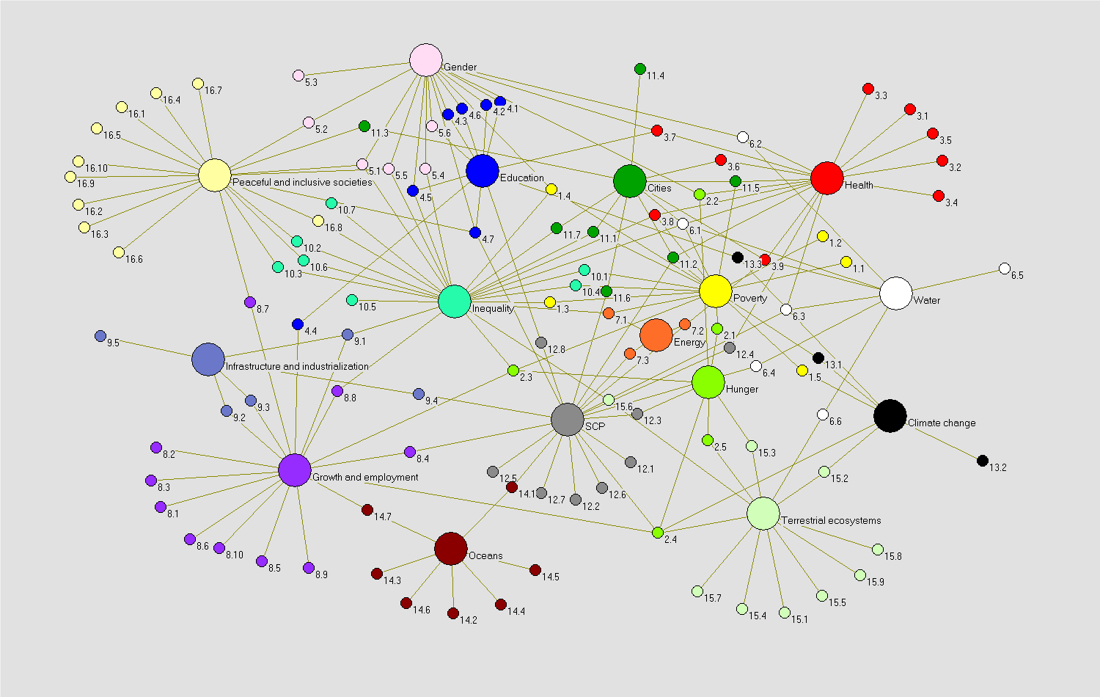
SDG principle: Interlinkages

Slide 14
SDG principle: Interlinkages
SDGs are integrated and indivisible;
Explicit recognition of complexity is the new normal;
Different ways to analyse inter-linkages.

Slide 15
SDG principle: Universality
All Member States commit to achieve the SDGs and implement Agenda 2030;
UN delivery increasingly focused on normative work/ Global Public Good and capacity development.

Slide 16
SDG principle: Partnerships
Key goal and implementation tool for Agenda 2030 and evaluation;
UN evaluation system experience through joint evaluations, Inter-Agency Humanitarian Evaluations, ISWE;
EvalPartners is a crucial achievement for the UN evaluation system;
New actors: Multi-Stakeholder Partnerships; Major Groups.

Slide 17
How can the SDGs be evaluated
Influencing elements: Design, Data, Demand;
Integration of principles into evaluation mandates, design and practice;
Evaluations that ‘talk to each other’;
The role of UNEG and its membership.

Slide 18
And finally…
Sincere thanks for your attention, questions are welcome!

