Slide 1
SDG Global Indicator Framework
2016 UNEG Evaluation Week High-level Event
Evaluation Fit for the 2030 Agenda for Sustainable Development
Rafael Diez de Medina, Chief Statistician
ILO Department of Statistics

Slide 2
Introduction
Agreement on a global indicator framework for monitoring progress towards achieving SDGs reached on 11 March 2016
Framework proposed by the Inter-Agency and Expert Group on SDG indicators (IAEG-SDGs) to the UN Statistical Commission, hosted by the Statistics Division of the UNDESA
Needs to be adopted by the Economic and Social Council (ECOSOC) in June 2016 and the General Assembly in September 2016 (or even earlier)

Slide 3
IAEG-SDGs
The IAEG-SDGs was tasked to develop an indicator framework for the SDGs at the global level, and to support its implementation
Composed of member States and includes regional and international agencies and civil society as observers
Annual report on progress towards the goals and targets at the global level (then regional and national)
Regularly review capacity-building activities in statistical areas
Meets physically twice a year and virtually as required

Slide 4
Features
Evidence-based, emphasis on statistical data
Focus on national ownership as data will be produced by national statistical systems
Importance of data disaggregation by income, gender, age, race, ethnicity, migratory status, disability, geographic location and other characteristics relevant in national contexts
Indicators do not necessarily cover all aspects of goals and targets
Data for several of the targets remains unavailable
Targets not always quantified

Slide 5
Different indicators
The indicators are classified into three tiers:
Tier I: an established methodology exists and data are already widely available
Tier II: a methodology has been established but for which data are not easily available for all regions
Tier III: an internationally agreed methodology has not yet been developed or it is not widely accepted or discussed and scarce info is available

Slide 6
Indicators Framework
The agreed Framework consists on:
 | Tier I | Tier II | Tier III | UD./Comb. | Total
Goal 1 | 3 | 4 | 4 | 1 | 12
Goal 2 | 7 | 2 | 5 | 0 | 14
Goal 3 | 15 | 7 | 3 | 1 | 26
Goal 4 | 3 | 4 | 2 | 2 | 11
Goal 5 | 3 | 4 | 6 | 1 | 14
Goal 6 | 6 | 0 | 5 | 0 | 11
Goal 7 | 4 | 0 | 2 | 0 | 6
Goal 8 | 10 | 6 | 1 | 0 | 17
Goal 9 | 8 | 1 | 3 | 0 | 12
Goal 10 | 4 | 0 | 5 | 2 | 11
Goal 11 | 2 | 7 | 6 | 0 | 15
Goal 12 | 1 | 3 | 8 | 1 | 13
Goal 13 | 0 | 2 | 4 | 1 | 7
Goal 14 | 2 | 0 | 8 | 0 | 10
Goal 15 | 6 | 1 | 5 | 2 | 14
Goal 16 | 9 | 7 | 6 | 1 | 23
Goal 17 | 15 | 2 | 5 | 3 | 25
 | 98 | 50 | 78 | 15 | 241

Slide 7
Further refinements
Calendar for revisión/review of indicators:
2017: specific proposals for refinements at the 47th. UNSC based on Tiers and new methodologies.
2017: A work plan for the review will be presented envisaging:
1st. Review of proposed refinements in 2020
2nd. Review of proposed refinements in 2025

Slide 8
Monitoring and Reporting
National, regional and global level
High-level political forum (HLPF) has been formed, which will be informed by an annual progress report on the SDGs prepared in cooperation with the UN system, based on the global indicator framework
The forum will have the central role in overseeing follow-up and review (NSOs are the members)
It will also conduct national reviews starting with 22 in July 2016, which are voluntary and driven by countries
Regional commissions to contribute to the regional reviews
Detailed mechanisms still being discussed

Slide 9
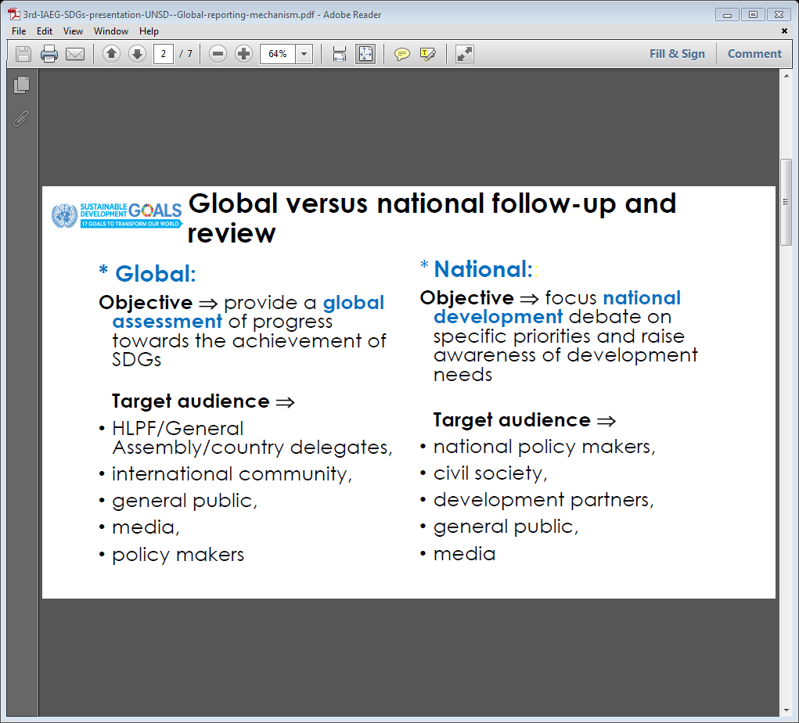
Global and national monitoring

Slide 10
Essential for Monitoring and Reporting
Quality, accessible, timely and reliable disaggregated data will be needed to help with the measurement of progress and to ensure that no one is left behind
Baseline data for several of the targets remains unavailable, which is essential for monitoring
Need for increased support for strengthening data collection and capacity-building in member States
Need to address this gap in data collection so as to better inform the measurement of progress

Slide 11
Baselines
Baselines should be based on best-practices and agreed baseline methodologies
Determination of baselines can follow different approaches:
–Multi-indicator or indicator-specific baselines
–Global, regional or national baselines
–Baselines for specific sub-population groups
Baseline setting needs to be consistent with the purpose of trend analysis, e.g.:
–Explore evolution over time of a single indicator a country
–Provide a global picture all indicators across many countries

Slide 12
Which baseline?
The MDGs were adopted in 2000 with an end date of 2015.
The baseline year for global tracking of MDG indicators was established as 1990 in order to allow for comparing trends before and after the adoption of the MDGs
The 2030 Agenda makes no specific reference to a baseline year(s) for global tracking
IAEG to decide on baseline selection criteria ?

Slide 13
Baselines (II)
2 Mentions of baselines in “Transforming our world: the 2030 Agenda for Sustainable Development”
- Para 57: “ We recognize that baseline data for several of the targets remains unavailable, and we call for increased support for strengthening data collection and capacity building in Member States, to develop national and global baselines where they do not yet exist.”
- Para 75: “The Goals and targets will be followed up and reviewed using a set of global indicators. These will be complemented by indicators at the regional and national levels which will be developed by Member States, in addition to the outcomes of work undertaken for the development of the baselines for those targets where national and global baseline data does not yet exist.”

Slide 14
Some implications
UNDAFs work at national levels
Filling the huge data gaps
Capacity building in Member states and constituents
Resources constraints: Global Partnerships, Data revolution, National budgets

Slide 15
Target and indicators on Data
Goal | Target | Indicator
Goal 17. Strengthen the means of implementation and revitalize the Global Partnership for Sustainable Development | 17.18 By 2020, enhance capacity-building support to developing countries, including for least developed countries and small island developing States, to increase significantly the availability of high-quality, timely and reliable data disaggregated by income, gender, age, race, ethnicity, migratory status, disability, geographic location and other characteristics relevant in national contexts | 17.18.1 Proportion of sustainable development indicators produced at the national level with full disaggregation when relevant to the target, in accordance with the Fundamental Principles of Official Statistics
 |  | 17.18.2 Number of countries that have national statistical legislation that complies with the Fundamental Principles of Official Statistics
 |  | 17.18.3 Number of countries with a national statistical plan that is fully funded and under implementation, by source of funding

