Slide 1
The Role of UNDP in advancing the sdgS
Date:
Dr. Indran A. Naidoo, Director

Slide 2
Outline
Evaluation is for learning
MDGs to SDGs to advance the Global Development Agenda
IEO assessment of UNDP’s role in MDGs will inform better realization of SDGs
UNDPs accorded role and responsibility for SDGs
UNEG’s role in providing technical support – the evaluability question
NEC IV Bangkok Conference launches collective approach to responding to SDGs imperatives
The Bangkok declaration: many parts, many players

Slide 3
Evaluation is for Learning
SDGs sets very high and ambitious targets - requires national commitments, effective development planning and action
Evaluation systems and capacities critical to generate high-quality evidence for progress monitoring and credible review
Evaluation systems are the bedrock that support countries to conduct their own assessments of SDG compliance

Slide 4
Evaluation is for Learning
Effectively conducted evaluation enhances quality of public investments which is a key governance tool for greater transparency, accountability, and learning
Evaluation of development if done in a participatory and credible manner drives development processes and helps concrete progress around areas such as South-South and Triangular Cooperation
Sharing of lessons and knowledge builds bridges across regions and sectors within countries – an imperative of the SDGs

Slide 5
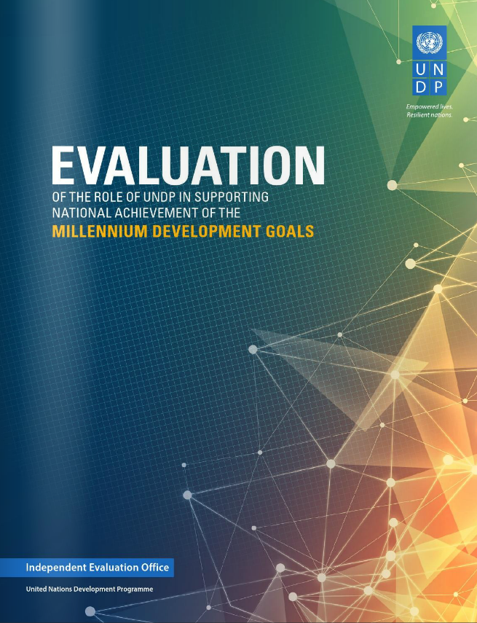
IEO’s Evaluation of the Role of UNDP in Supporting National Achievement of the Millennium Development Goals
This evaluation:
  assessed the roles played and results achieved by UNDP in support of the achievement of the MDGs,
  identified factors which affected the contribution and performance of UNDP and identified strengths and weaknesses, in past performance as well as threats and opportunities for future engagement in this area
  It was a key lesson for UNDPs engagement around finalizing MDGs and preparing for SDGs and the recommendations were committed to

Slide 6
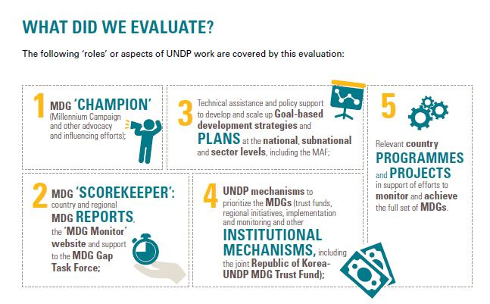
IEO’s Evaluation of the Role of UNDP in Supporting National Achievement of the Millennium Development Goals

Slide 7
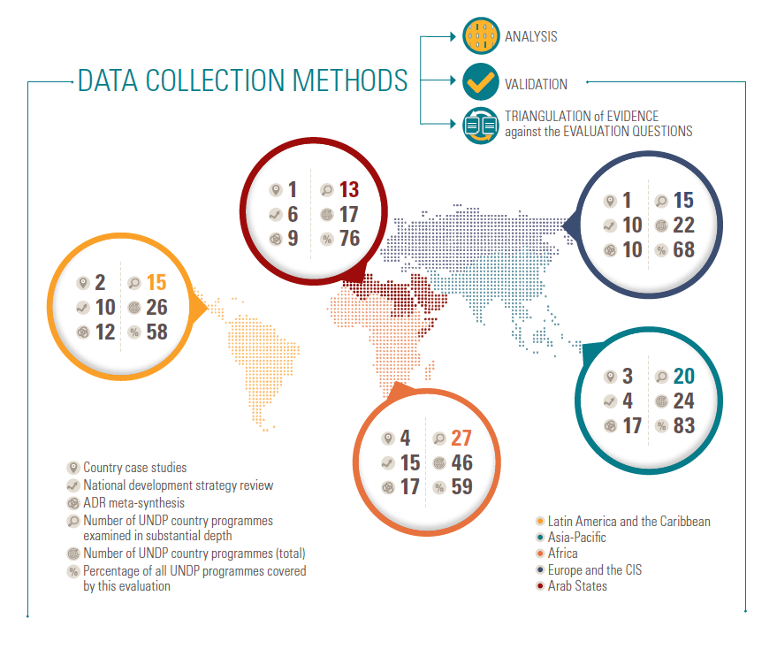
IEO’s Evaluation of the Role of UNDP in Supporting National Achievement of the Millennium Development Goals

Slide 8
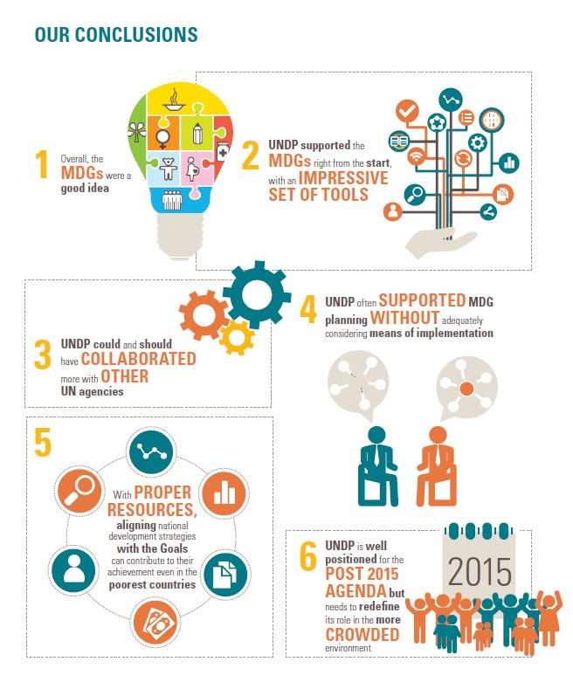
IEO’s Evaluation of the Role of UNDP in Supporting National Achievement of the Millennium Development Goals

Slide 9

UNDP’s Accorded Role and Responsibility for SDGs
For MDG implementation, UNDP partnered with national authorities to produce over 500 MDG country reports for score keeping
UN Secretary-General has agreed that UNDP should now play the same role with national reporting on the SDGs within the framework of the Global Partnership on Sustainable Development Data

Slide 10




UNDP’s Accorded Role and Responsibility for SDGs
All 17 Sustainable Development Goals are connected to UNDP’s Strategic Plan focus areas: sustainable development, democratic governance and peacebuilding, and climate and disaster resilience
UNDP’s focus in the future is on :

Slide 11
UNDP’s Accorded Role and Responsibility for SDGs
As chair of the United Nations Development Group (UNDG), UNDP will be rolling out a package of tools and services to support governments as they localize, review and evaluate their progress against the SDG agenda
‘MAPS’ Mainstreaming, Acceleration and Policy Support is meant to:
Support governments to reflect the new global agenda in national development plans and policies.
Support countries to accelerate progress on SDG targets
Make UN’s policy expertise on sustainable development and governance available at all stages of implementation

Slide 12
UNEG’s Role in Providing Technical Support – The Evaluability Question
UNEG shall provide professional expertise to agencies so that:
The evaluability challenges, opportunities and issues are properly considered in the Agenda 2030
Support the on-going indicator development work
Advise on instruments and methods that are appropriate for various contexts, so that the evaluability assessment are credible
Equip members and their agencies with the requisite expertise on the subject to help build support for evaluation at various levels, so that there are well crafted evaluation strategies, plans and approaches and
There are harmonized approaches to mitigate against the potential risks of fragmented and non-coherent approaches which undermine the credibility of the evaluation effort

Slide 13
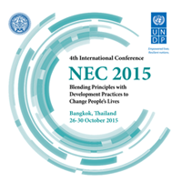
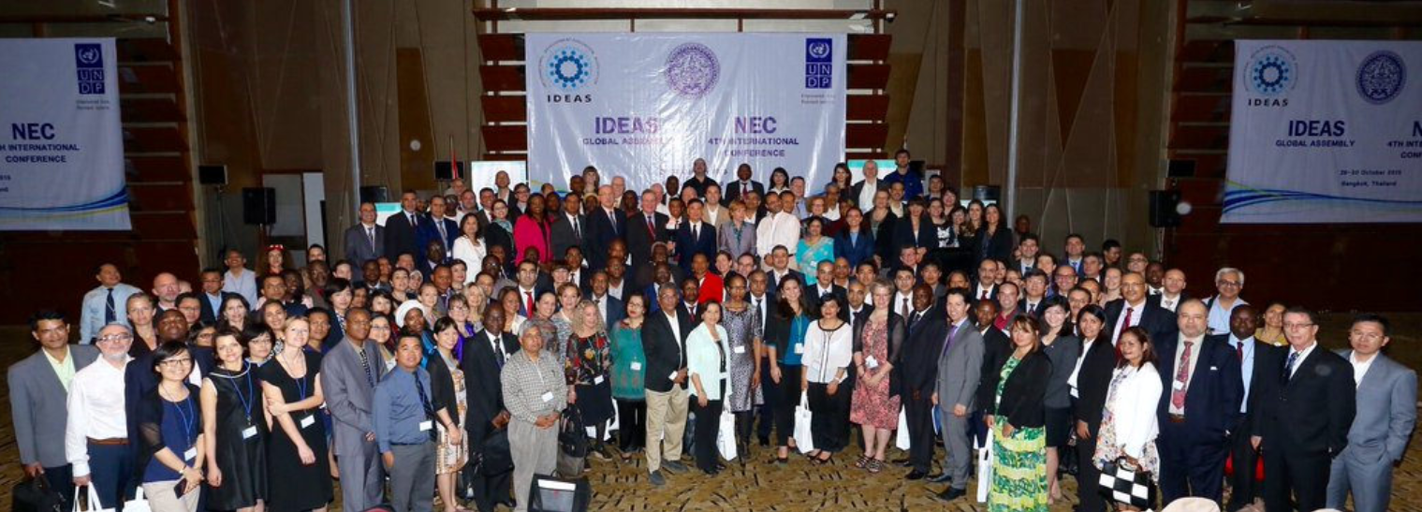
NEC IV Bangkok Conference Launches Collective Approach to Responding to SDGs Imperatives
Largest evaluation event globally by government and country participation – broke all records - 100 countries, 450 participants
Civil society, academia and research community held historic discussion on what SDGs means in practice from a results perspective
First time collaboration between all three international evaluation networks – UNEG, ECG and OECD/DAC and IDEA

Slide 14
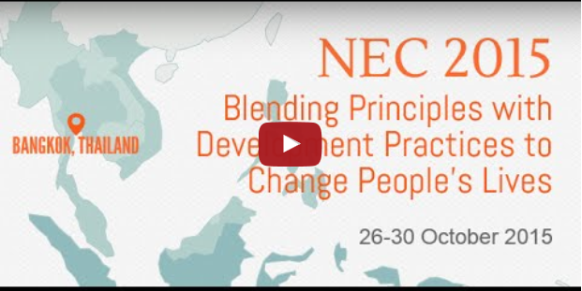
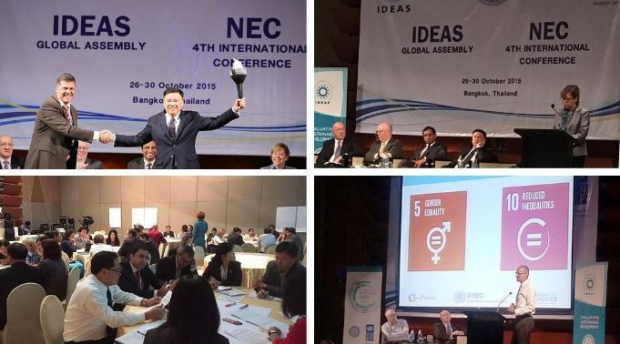
NEC IV Bangkok Conference Launches Collective Approach to Responding to SDGs Imperatives
Critical dialogue was held on how to build national evaluation capacities to tackle the challenge of monitoring and evaluating the Sustainable Development Goals
NEC 2015
450 participants from >100 countries
Bangkok Declaration

Slide 15
Many Parts, Many Players and its Principles
NEC 2015
Bangkok Declaration
Seeks to capture an emerging body of shared understanding on lessons and priorities for evaluation practice in the era of the SDGs to help guide joint action in future support of national evaluation capacity
‘SDG’s intentions for follow-up and review processes are specifically guided by objectives that evaluation function directly responds to (inter alia):
identify achievements, challenges, gaps and critical success factors
support the identification of solutions and best practices and promote coordination and effectiveness of the international development system
be open, inclusive, participatory and transparent for all people
build on existing platforms and processes
be rigorous and based on evidence, informed by country-led evaluations and data
require enhanced capacity-building support for developing countries, including the strengthening of national data systems and evaluation programs’

Slide 16
Many Parts, Many Players and its Principles
NEC 2015
Bangkok Declaration
‘In moving forward in support of national evaluation capacity, the declaration recognizes the following types of efforts and initiatives as among options that warrant consideration:
Conduct of country-level ‘SDG evaluation needs’ reviews and diagnostic studies
Evaluability assessments pertaining to individual country or sector SDG goals and targets
Fostering of evaluation as component of national governance and public sector management reform
Establishing national evaluation legal frameworks - legislation and policies
Developing clear national and local sub-national level mechanism for independent evaluation of progress against the SDGs

Slide 17
Many Parts, Many Players and its Principles
NEC 2015
Bangkok Declaration
Assigning resources (a percentage of the initiatives’ costs) for the conduct of evaluations when realigning national plans with the SDGs and when designing/approving projects/programs/policies
Strengthening national and local data systems to monitor SDG progress
Establishing frameworks of formal competencies and professional evaluation standards
Establishing evaluation training programs within academic and public sector professional training institutions
Creating opportunities for local, young and emerging evaluators
Developing systems to promote transparent follow-up of evaluations recommendation
Support national, regional and global evaluation professional organizations
Support international forums of exchange between users and producers of evaluation, via the right of access to information, including regional workshops and web-based platforms for knowledge management’

Slide 18
How Monitoring and Evaluation Capacities and Bangkok Declaration can help this broader agenda
Taking a large definition of Evaluation : information and knowledge to design, monitor and evaluate policies and programs
Considering that information and knowledge on Evaluation should be taken to all levels of government, because everyone plays a role on program improvement
Helping to build an inventory of documents on well succeeded public policies and programs around the world
Helping to build capabilities to produced statistical data and national registers around the world

Slide 19
Download through links
NEC 2015 Conference
Sustainable Development Goals
Mainstreaming the 2030 Agenda, Reference Guide
IEO’s Evaluation of the Role of UNDP in Supporting National Achievement of the Millennium Development Goals
Bangkok Declaration
Bangkok Declaration

Slide 20




Thank you
United Nations Development Programme
Independent Evaluation Office
220 East 42nd Street
New York, NY 10017
www.undp.org/evaluation

