Slide 1



UNDP’s contribution to gender equality and women’s empowerment (2008-2013)
Analytical frameworks
April 2016
/UNDP_Evaluation
/IEOUNDP

Slide 2
Contents
Background
Gender Results Effectiveness Scale (GRES)
Gender@Work Quadrants of Change
Recommendation & Moving Forward

Slide 3
Background
A key question of the evaluation is: Has UNDP contributed to development results in gender equality and women’s empowerment?
The evaluation created database of 260 gender results from 62 ADRs and 14 country visits
“Gender results” outputs or outcomes assessed to be contributing (positively or negatively) in UNDP interventions to gender equality and women’s empowerment.
Analytical frameworks are needed to assess these gender results.

Slide 4
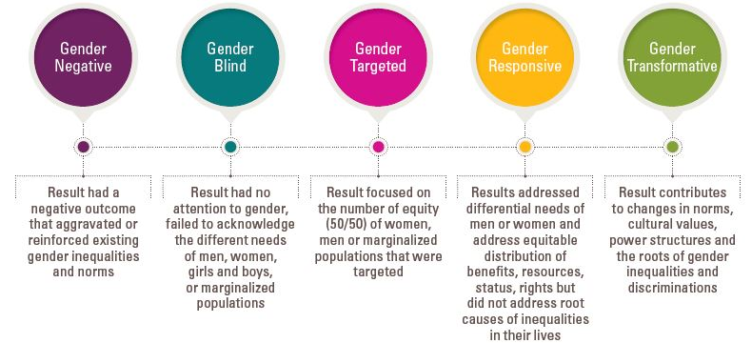
Analytical Frameworks: GRES

Slide 5
Gender Results Effectiveness Scale (GRES)
The Gender Results Effectiveness Scale (GRES) was created by the IEO evaluation team to make visible the quality issues that are often absent in accountability and reporting systems
It was created to categorize what is usually not categorized: the level of effectiveness or the quality of gender results
There are many different variations that a seemingly similar outcome can take
To capture this variation, GRES was created with 5 results categories

Slide 6
Key Considerations
There are contextual issues which are important to include to interpret the GRES categorization.
Results may evolve over time:
Gender-targeted or gender-responsive results have the potential to become transformative
Because underlying power structures are being tackled, there is also the possibility of reversal or backlash

Slide 7
Applying the GRES
Gender results were overwhelmingly “gender targeted” meaning they were limited to counting the numbers of men/women involved.
Only exception was in the Democratic Governance areas where they were “gender responsive” and addressed the different needs of men and women.
Instances of backlash (barriers to or reversals of progress) were reported across all thematic areas

Slide 8
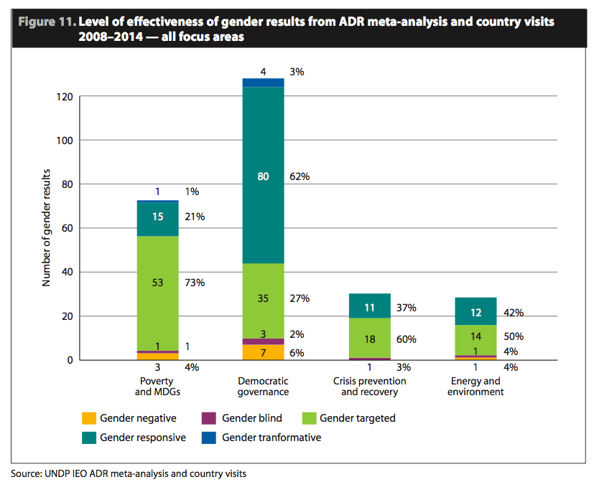
Applying the GRES (cont’d)

Slide 9
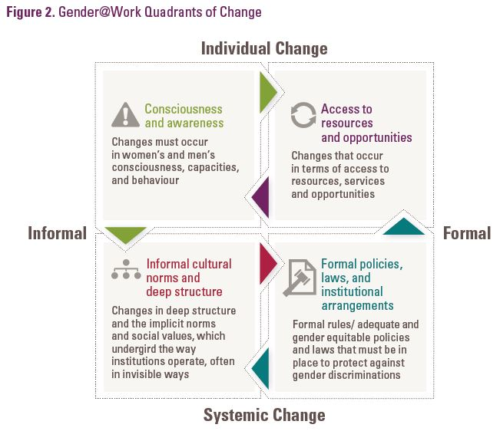
Analytical Frameworks: Gender@Work

Slide 10
Gender@Work Framework
The Gender@Work framework, developed by an international collaborative that helps organizations to build cultures of equality and justice, identifies the areas of change that must occur to achieve transformative change
In addition to using the GRES to understand the quality of gender results, the Gender@Work framework was used to better understand the types of changes UNDP most often contribute to.

Slide 11
Applying the Gender@Work
Most UNDP outcomes contributed to improving access to resources/opportunities, changed laws and policies and strengthened awareness.
Very few signaled systemic changes in internal culture (a prerequisite for ‘transformative’ change’)

Slide 12
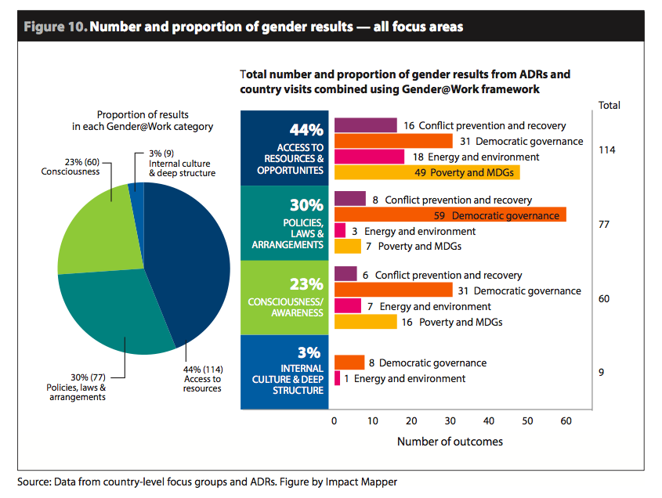
Applying the Gender@Work

Slide 13
Moving Forward
A key recommendation of the UNDP’s gender evaluation is that given the lack of measurement standard to track type, quality and effectiveness of gender results, UNDP should codify the way it wants to monitor, report, evaluate and audit its contribution to gender.
UNDP management agrees to consider adopting measures such as the Gender@Work framework to move beyond a focus on number of women and men towards more transformative results.
IEO will apply the GRES and Gender@Work in its country-level evaluations

Slide 14

Evaluation on UNDP Contribution to Gender Equality & Women’s Empowerment
http://web.undp.org/evaluation/evaluations/thematic/gender.shtml

Slide 15




THANK YOU!
Independent Evaluation Office
220 E 42nd St 20th floor
New York, NY 10017
http://www.undp.org/evaluation

