Slide 1
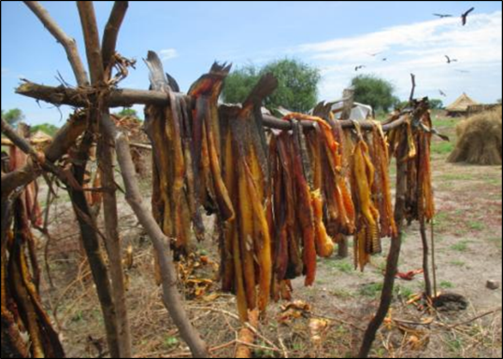
Participatory impact assessments in protracted crises and conflict contexts
Methodology lessons from South Sudan
UNEG EPE 2016 –Humanitarian Stream:
Evaluation methodology panel
Marta Bruno FAO

Slide 2
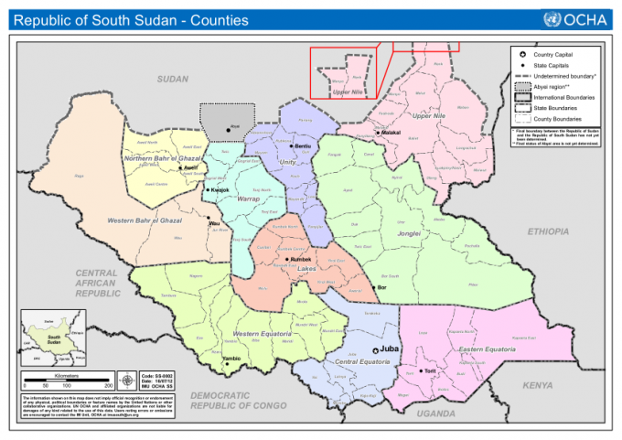
Participatory Impact Assessment of FAO 2014 livelihood kits emergency distribution
provide qualitative analysis on results and impact at community level
identify the intended, unintended, positive and negative impacts of FAO’s distribution of livelihoods kits in 2014
provide findings for the FAO country team and the main evaluation

Slide 3
Main research/evaluation questions
Weak context analysis changes in livelihoods over time?
Absence of ‘results’ focused monitoring data What was the initial impact of LH kits?
Delivery through implementing partners effectiveness of the partnership and their feed-back?

Slide 4
Overview of the process:
Scoping in HQ
interviews
portfolio
Inception
in SS
feasibility
ToRs
Team selection
call and interviews
Main mission
Pilot
ToT and methodology
Finalization of methods
Training
Field-work
Analysis and reporting
workshop
writing
validation
Dissemination and utilization

Slide 5
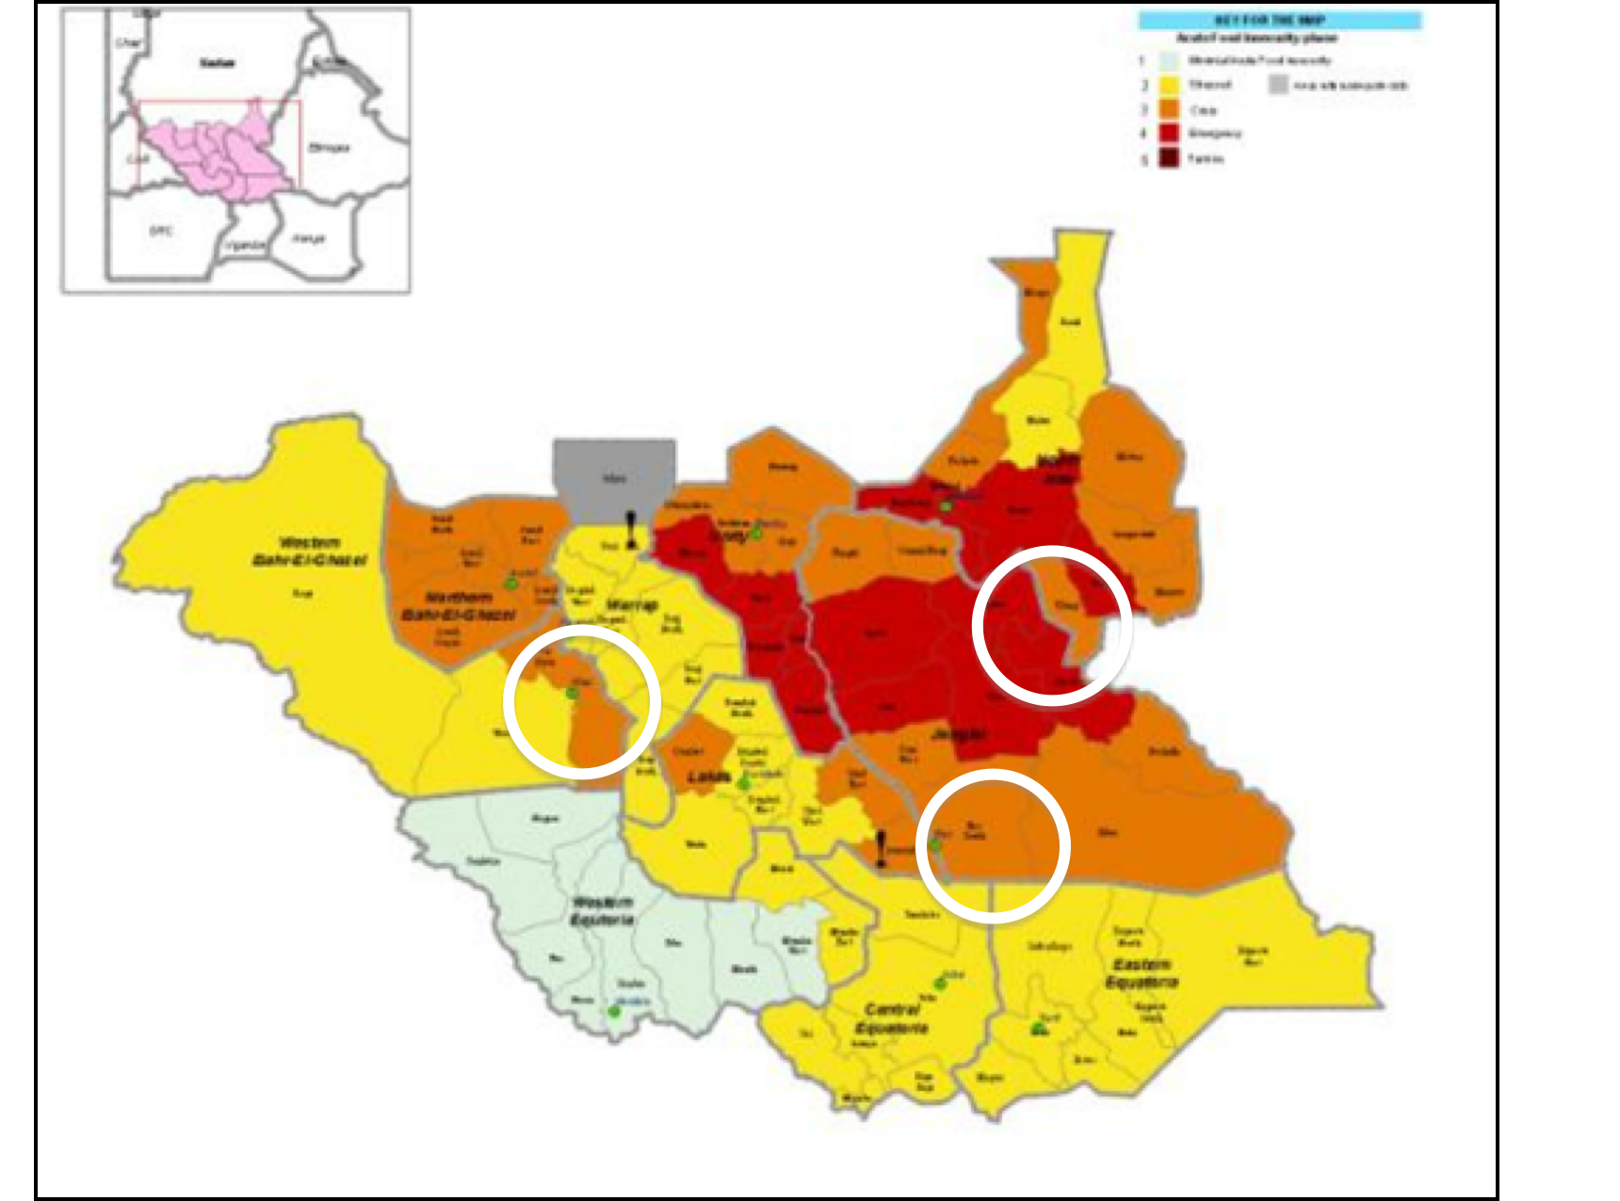
Selection of the sites
Two states: Jonglei and WBeG
Four counties: Akobo, Bor, Jur River and Wau
13 Payams and 17 villages
Government and opposition controlled areas
Control villages and households
IPC areas 2-3 and 4 (on map)
Different agro-ecological zones (flood plains, iron plateau, Nile river)

Slide 6
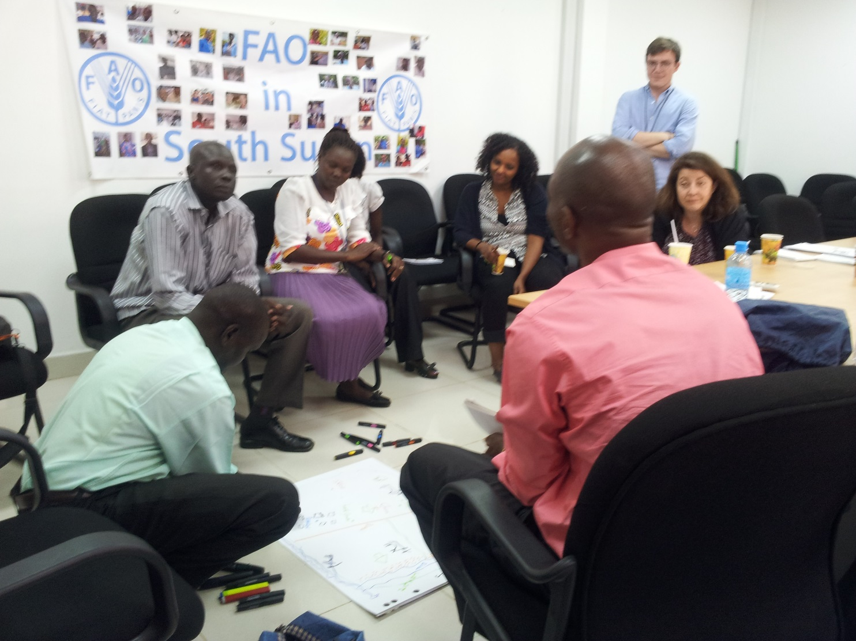
Selection of the team
IAHE experience
Selection process to ensure access
Gender balance
Inclusion of FAO M&E and gender officers
Ensuring coherence and similar skills sets across teams
EM and coordinator
Area coordinator and team
enumerators
Area coordinator and team
Enumerators
Area coordinator and team
Enumerators

Slide 7
Organization of the team
Area coordinator and team
Wau
Enumerators
Evaluation Manager and coordinator
Area coordinator and team
Bor
Enumerators
Area coordinator and team
Akobo
Enumerators

Slide 8
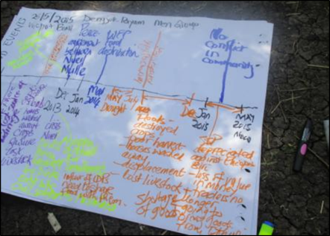
Getting the team and the methodology ready
Face to face ‘classic’ training on PRA
Progressive handing over lead on training to team members
Joint review and refinement of the methodology through testing in training
Team developed ToT materials and ‘protocols’
Pilot testing of methodology
While in the field: feed-back and exchange across teams in different locations
Daily de-briefs and note consolidation to be shared

Slide 9
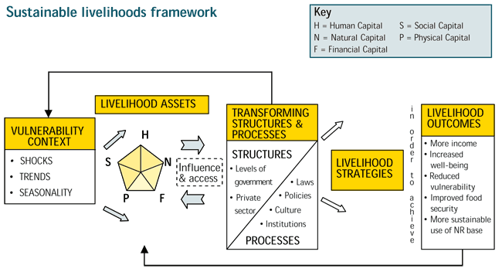
Methodology considerations 1
The good old livelihoods framework is still extremely useful for:
Consolidating thoughts, concepts and know-how through an understanding of complex socio-economic and development contexts
Ensuring that different teams use the same organizing framework and check-list
Supporting coherent and systematic data anlysis at the end of the process

Slide 10
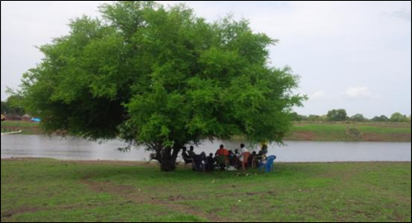
Methodology consideration 2
Use of PRA tools for the community level:
Data: 33 FGDs and 426 participants
Maps to quickly understand the development context and the issues
Timeline to reconstruct a baseline and change over time
Venn Diagrams to explore the relationships, actors and dynamics

Slide 11
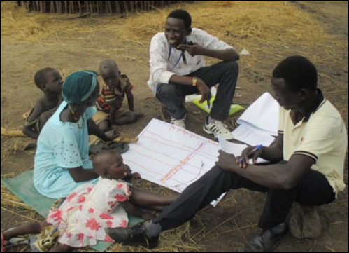
Methodology consideration 3
Use of PRA tools for the household level:
Data: 84 recipient HH and 29 non-recipient (50% of both HH groups were female headed)
Household economy matrix to understand the incomes, expenditures and coping strategies of households
Daily activity clocks to understand the gender and nutrition aspects

Slide 12
Learning from the experience
Lessons on planning and methods…
Logistics and flexibility: plan big
Seasonality and migration (people and livestock)
Triangulation and attribution are difficult
Language
… and on teams and methods
Must use national teams
Allow plenty of time for training
Ensure communication flows amongst teams during field-work
Record data in writing but plan for oral analysis
Coordination and QA on a daily basis

Slide 13
As a conclusion:
The Participatory Impact Assessment was used as a basis for the 2016 planning of FAO response activities (with corrective action)
It was used as the main source of data on the results level by the main evaluation
It provides lessons and methods for similar studies in other countries/evaluations

