Slide 1
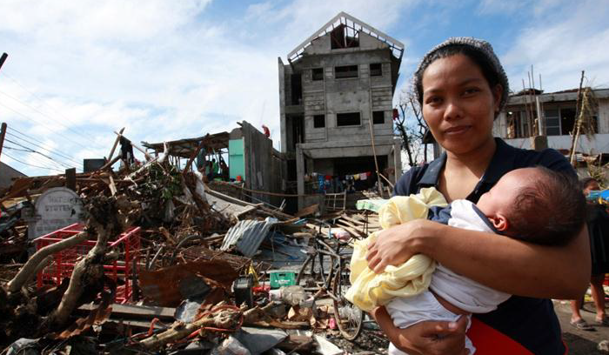
Engagement with people affected by crises in evaluation: experience of IAHE Typhoon Haiyan
Teresa Hanley, Independent Consultant, VALID
Team leader, IAHE Typhoon Haiyan

Slide 2
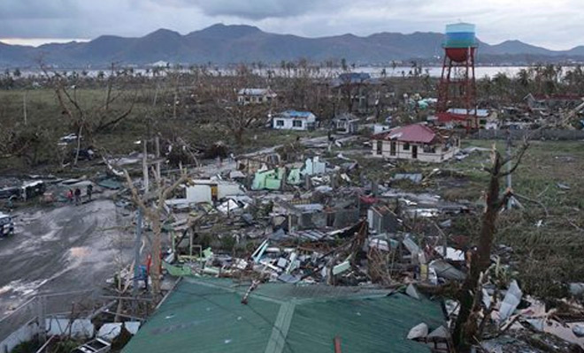
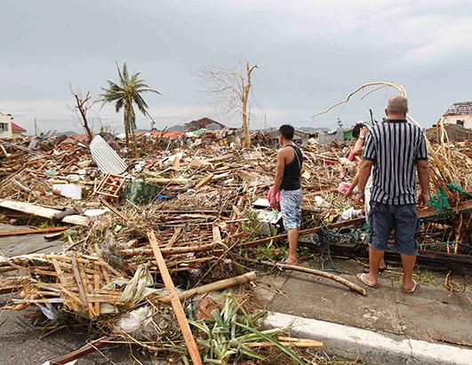
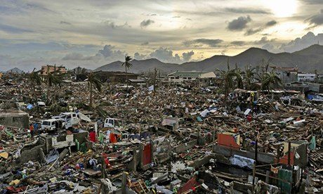
CONTEXT
Typhoon Haiyan (Yolanda) made landfall 8 November 2013- L3 emergency declared
Over 6000 killed; 4 million homeless; 14M affected
Evaluation in month 10 of 12 month SRP
4 person team
Approx 3 weeks field work

Slide 3
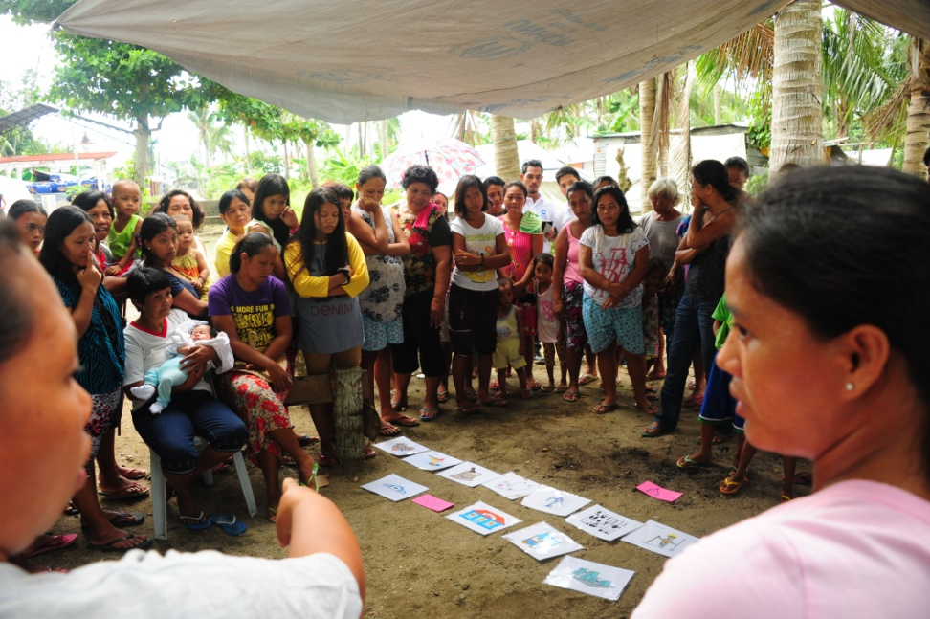
Community consultation methodology
Range of communities identified- 3 regions, rural-urban etc
Half day in each
Step 1- Community builds their response timeline
Step 2- Discussion on relevance, timeliness, effectiveness, accountability and transparency, quality/social difference
Questions adapted and localised
Step 3- Ratings established as a group 1-5
Filipino facilitator-local languages and scribe

Slide 4
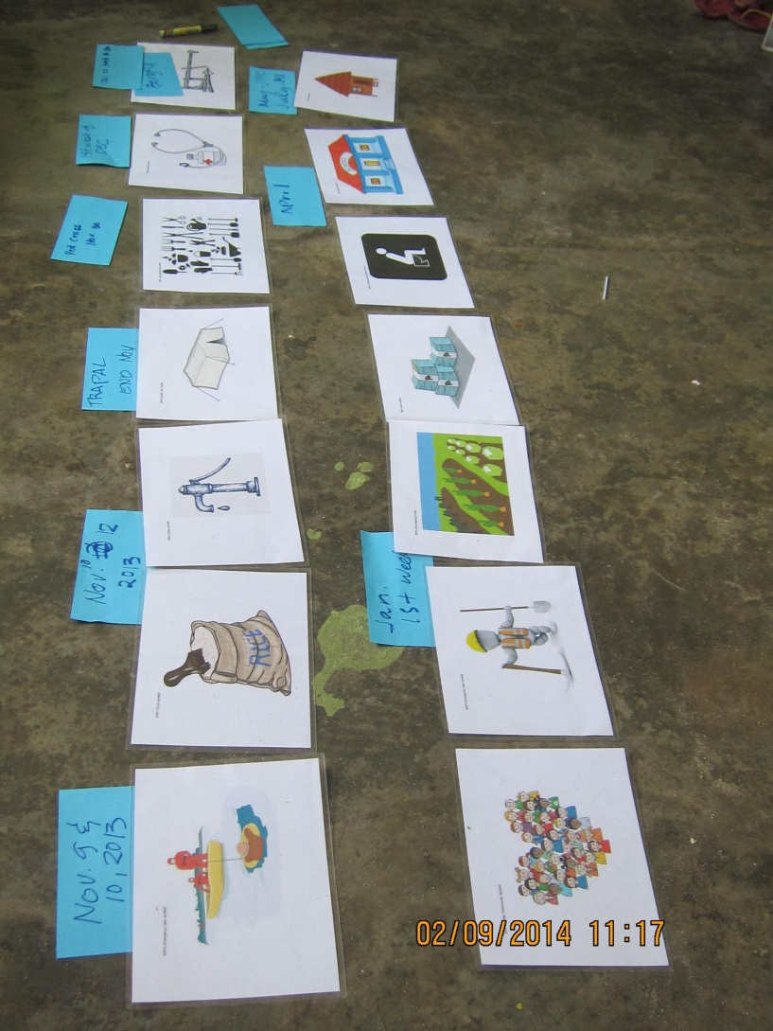

Slide 5
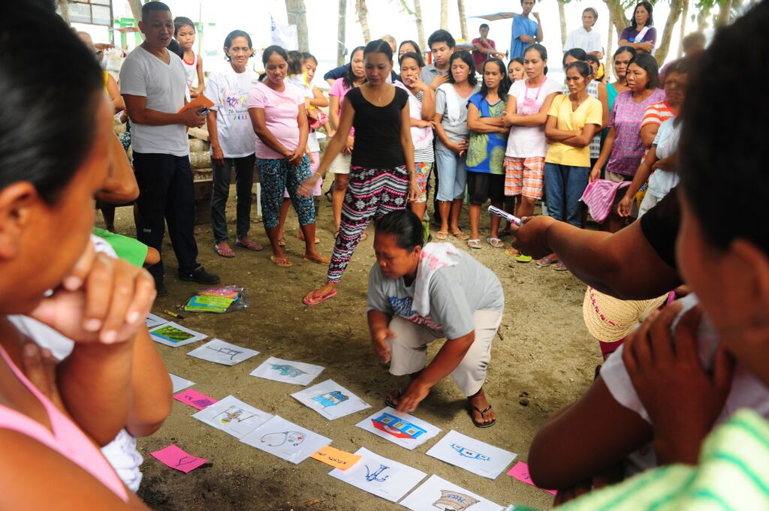
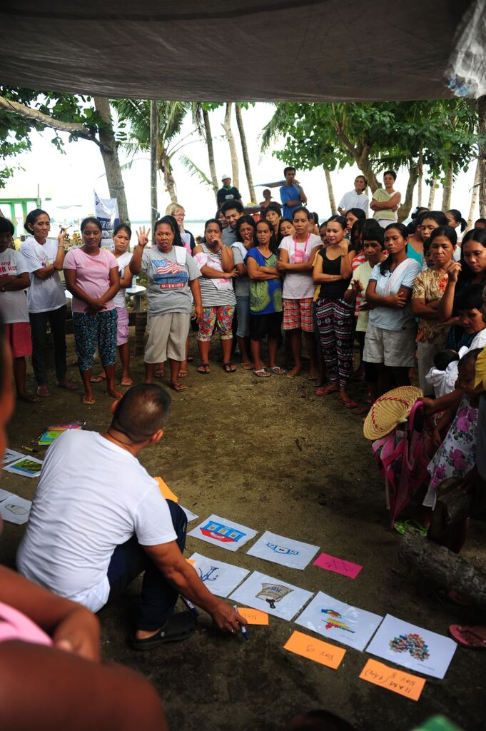
Key principles underlying approach
1. The Power of Symbol
2. The Power of Position
3. The Power of Time
4. The Power of Space
5. The Power of Numbers

Slide 6
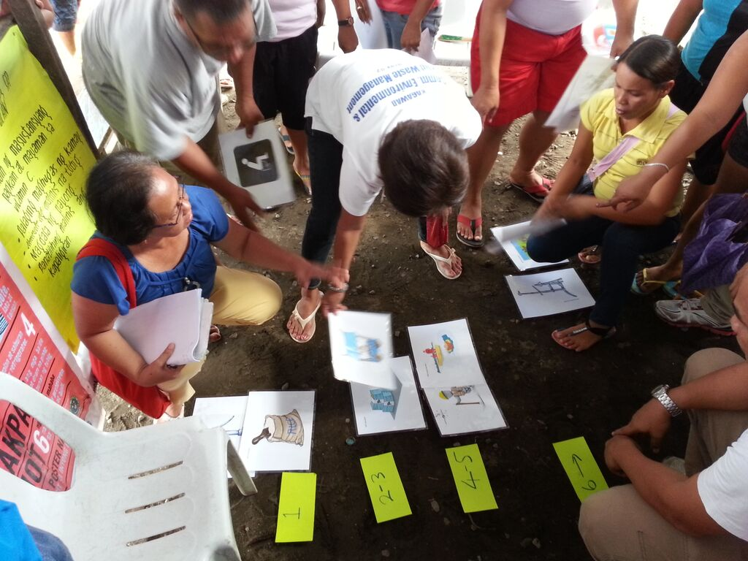
Methodology
Complemented by additional community activities (FGD, KII) and AAP data
Generated data on trends and different experiences between communities

Slide 7
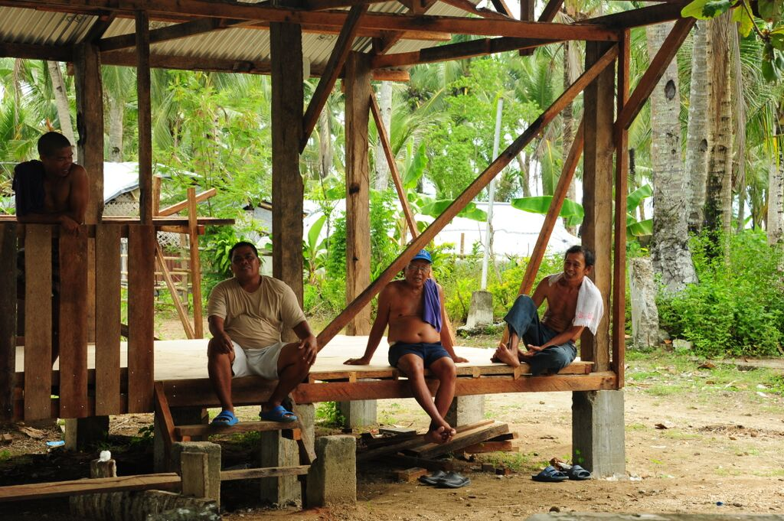
Constraints and challenges
Limited number of communities
Needs complementary activities to ensure coverage
Community consultation fatigue
Feedback to communities limited to evaluation findings
Evaluation focused on HCT-led response but overall response much broader-feedback is on all

Slide 8
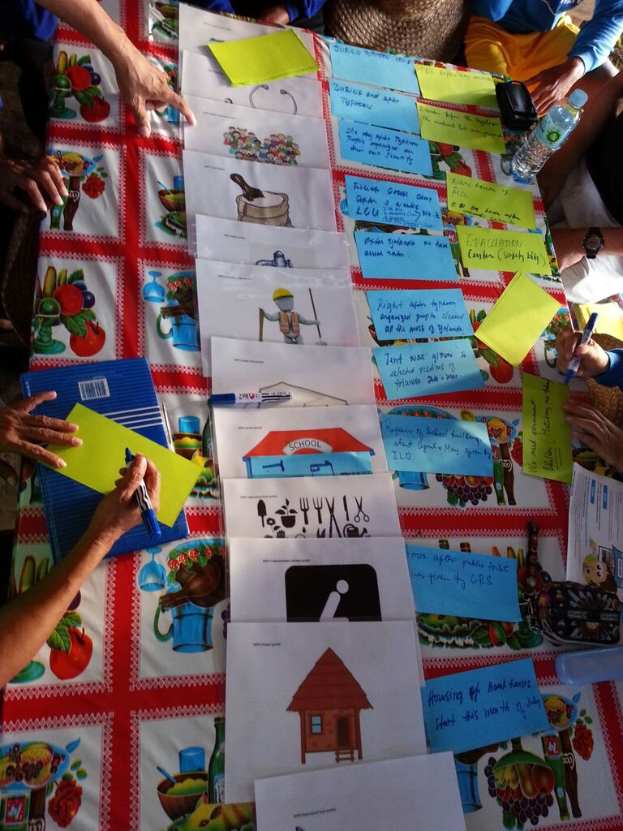
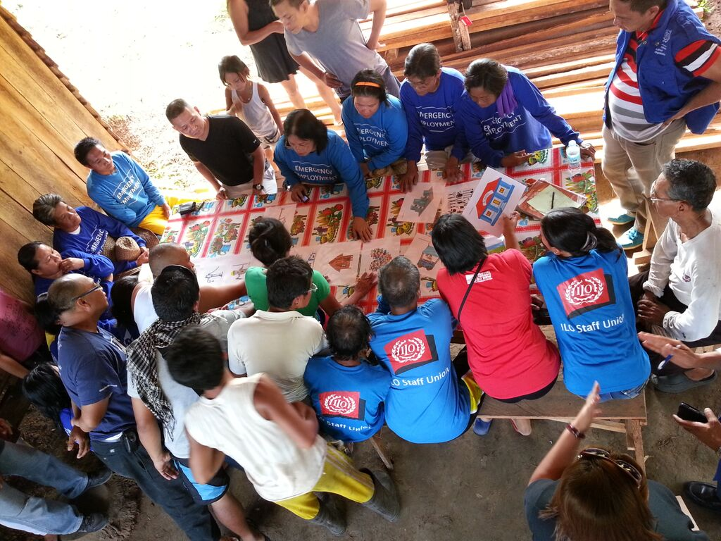

Slide 9
Learning and reflections
Potential of working with large groups in short time
Value of scoring but for trends and qualitative data only
Factors which helped -data availability, community comfort with participatory processes; great facilitators
Need to think through how to combine with AAP processes through response and agency own evaluation
What’s the right balance-affected population input v management etc issues?

Slide 10
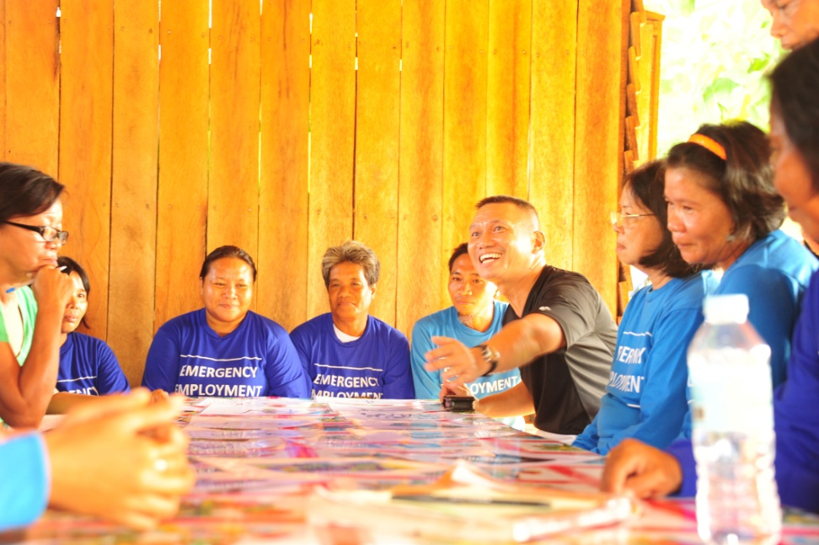
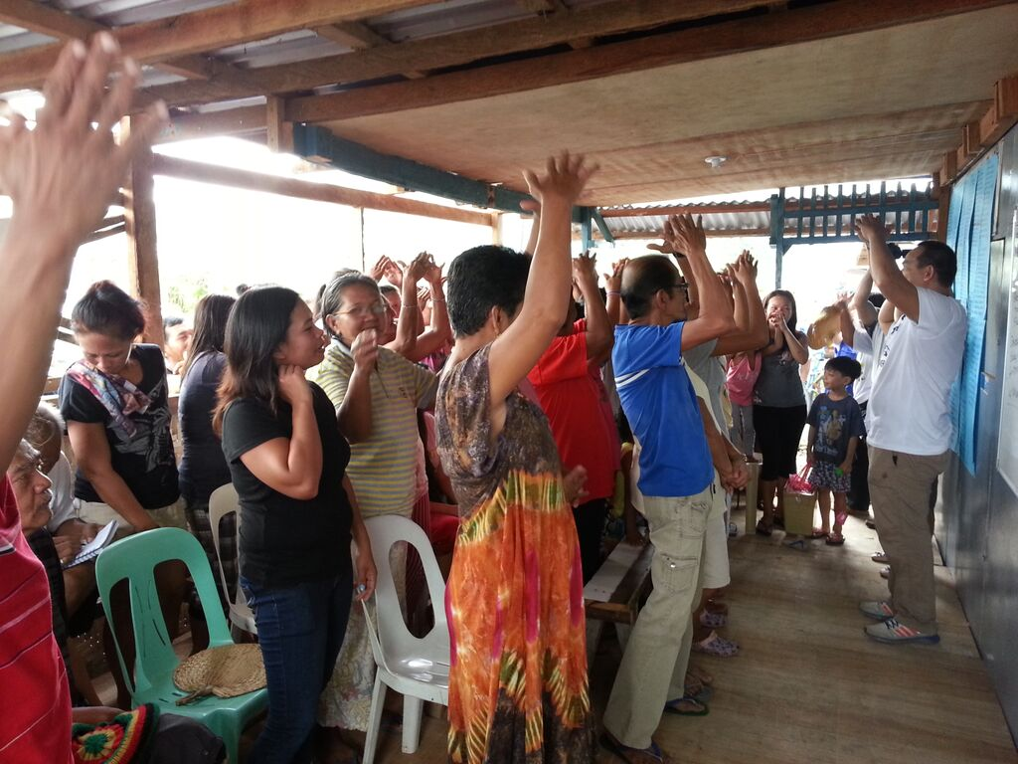
The facilitators

Slide 11
Thank You!
Teresa Hanley
thanley7@gmail.com

