Slide 1
Independent System-Wide Evaluation (ISWE)of United Nations Operational Activities for Development:
Methodological lessons learned from the pilot evaluations
Presentation to UNEG Evaluation Practice Exchange
(26 April 2016)

Slide 2
Session Objectives
Provide a general briefing related to the ISWE policy
Share methodological lessons related to the testing of two pilot ISWE evaluations
UNEG EMG members offer their perspectives on the new mechanism

Slide 3
Presentation Outline
Background and objectives of the pilot ISWE Mechanism – Scott Green, ISWE Secretariat Coordinator
Results of the testing of the Comprehensive Evaluation Modality – Michael Reynolds, Independent Evaluation Consultant
Results of the testing of the Synthesis Evaluation Modality – Scott Green
Brief Perspectives from EMG Members – Inga Sniukaite, UN Women and Krishna Belbase UNICEF
Moderated discussion and concluding remarks – Inspector Sukai Prom- Jackson of the Joint Inspection Unit (JIU)

Slide 4
System Wide Evaluation and the UN Fit for Purpose debate
The UN is seeking to position itself in a global context of massive and fast moving changes. In this context, it needs evidence-based information on its overall performance in programme countries and on how it should strategically position itself to add value in a context of multiple development partners. ISWE initiative is set to provide evidence on whether the UN system is:
doing the right things in the right way?
making a difference and adding value?
enhancing the attainment of impact ensuring sustainability?
could the UN do things differently?

Slide 5
The Fragmentation Challenge
Currently, evaluations of operational activities by the various UN system organizations are segmented, dispersed, and cannot by be easily aggregated or synthesized to support decision making about the UN system as a whole.
Governing bodies as well as Member States of the UN system need more integrated and comprehensive knowledge about the effectiveness of United Nations operational activities for development to improve coherence, support mutual accountability, and enhance effective decision making at a system-wide level.
ISWE supports the challenge of the SDGs by breaking down UN institutional barriers, encouraging holistic approaches and systems thinking and as one of its fundamental principles seeks to build national evaluation capacities.

Slide 6
ISWE Overall Purpose
The purpose of independent system-wide evaluation of operational activities for development is to strengthen governing bodies in their role for oversight, accountability, decision making, and direction setting of the UN system as a whole. It supports system-wide coherence and contribution to development effectiveness and sustainability.
Objective 1: Functions, systems and mechanisms for management and for the conduct of evaluation
Objective 2: Piloting of 2 modalities of system-wide evaluation

Slide 7
ISWE Objective 1
The ISWE policy recognizes the JIU mandate for Independent system-wide evaluation and seeks to strengthen the capacity for the conduct of independent system-wide evaluation of UN operational activities for development.
It seeks to enhance partnership making use of existing evaluation mandates, mechanisms and capacities of the JIU and evaluation functions of UN system organizations;
It makes use of Evaluation Management Groups (EMG) chaired by the JIU and having membership of evaluators from UN system evaluation offices to enhance professional technical quality;
It seeks to enhance and strengthen the strategic and substantive value, ownership and utility through establishment of Key Stakeholder Reference Groups (KSRG);
It makes use of external expert consultants to enhance the quality and efficiency of the evaluation.

Slide 8
ISWE Objective 2
The second objective of the policy is to conduct two pilot evaluations addressing two of three identified evaluation modalities for system-wide evaluation. The two modalities piloted in 2015/2016 are: a comprehensive evaluation, and a synthesis evaluation.
The pilot evaluations evaluate whether the UN system as a whole is responding to country needs and priorities and making progress towards internally agreed development goals; whether it does so in an appropriate manner that is efficient, coherent, and ensures sustainability; and whether it is making a contribution to development results of programme countries and strengthening the capacity for impact;
The pilot evaluations also provide information on what is required to carry out the two modalities of system-wide evaluation and the lessons for the future.

Slide 9
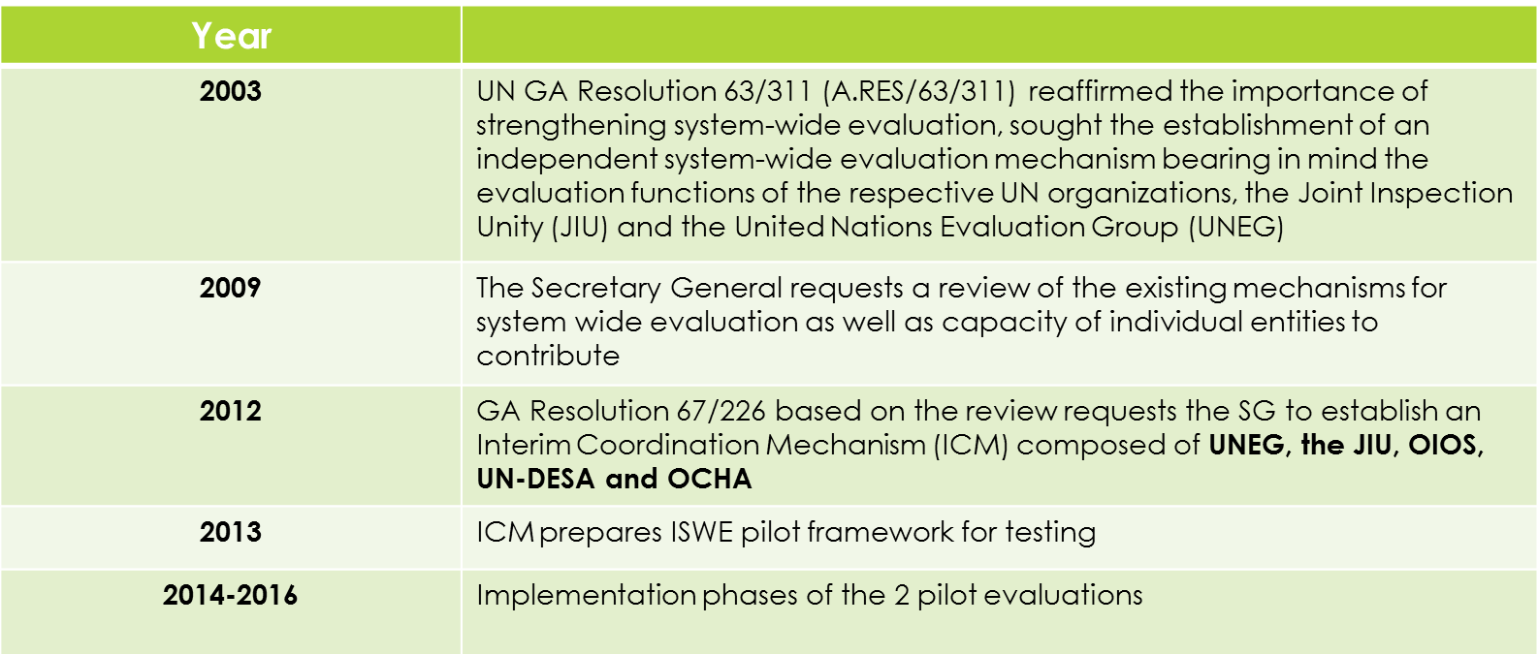
ISWE Milestones

Slide 10
ISWE Governance Mechanism
Key Stakeholders Reference Group
Identifies key issues and questions of strategic importance for evaluated topic
Reviews and comments on draft evaluation report for quality, credibility and clarity
Helps disseminate report findings and promotes its use
Commissioning Body
Calls for an evaluation
Reviews and discusses ISWE Report
Accepts/rejects Report and follow-ups on implementation of recommendations
Submits Evaluation Report through JIU
Commissions
Annual Report submission
Evaluation Management Group
Approves framework for overall approach (submitted by ISWE Secretariat)
Approves TOR
Approves budget for the evaluation
Serves as tender committee and selects evaluation team(s) commissioned to conduct the actual evaluation
Guides and approves inception report on scope, design and plan
Approves evaluation products including final report after verifying quality, credibility and clarity
Supports JIU in submitting final report
During the Pilot Period
ISWE Coordination Secretariat
Manages daily ISWE under EMG
Scopes and conceptualizes/designs evaluation
Resource mobilization
Contracts the evaluation team
Executes quality control of evaluation process
Manages the budget
Coordinates ISWE activities with other actors in the system
Acts as interface between ISWE and POs
Designs communication and utilization strategy
Follow-ups on recommendation uptake and implementation
Prepares/finalizes a summary report of each ISWE commissioned
Annual Report to ECOSOC
ISWE Evaluation Team

Slide 11
What is a comprehensive evaluation – ISWE policy
ISWE Policy definition: These evaluations apply a common framework to produce in-depth evaluations of specific policies, strategies, programmes, issues, efforts, areas or sectors in a single or in several countries, which are then synthesized into one study.

Slide 12
Full Title of the Pilot
"Evaluation of the contribution of the United Nations development system to strengthening national capacities for data collection and analysis to support the achievement of the Millennium Development Goals and other internationally agreed development goals”

Slide 13
The scope of the evaluation
About 30 UN system entities – specialized agencies, funds and programmes, regional commissions, UN secretariat;
Large number of national stakeholders – national statistical office, line ministries, central bank, planning body – all producing statistics plus users in private sector, civil society;
The evaluation covered the period from 2000 but realistically focused on the last 5 years;
About 120 UN Country Teams engage in national statistical capacity development;
Not just about statistics but about capacity development, UN county level coordination, partnerships and the political economy of use.

Slide 14
The ISWE Policy identified advantages/disadvantages in the approach
The advantages of this approach is that it:
generates new knowledge from purposefully selected cases;
engages the partner countries extensively in the conduct of evaluations;
builds on and enhances national evaluation capacity.
The disadvantages of this approach are that it is:
costly;
takes a long time;
requires an intensive coordination effort.

Slide 15
What happened during implementation – the policy was right!
Not enough time – future ISWEs need to be undertaken over a period of years;
Uncertainty over money – budgets need to be secured up front;
Administrative blockages – very strong dedicated evaluation management is required.

Slide 16
The approach was therefore dictated by these realities
Country studies as the core source of evidence in line with the ISWE policy;
But the evaluation promoted little national evaluation capacity development;
Nor was there as extensive engagement with national partners in the countries as hoped
Other sources of evidence also became very important, especially evaluations;

Slide 17
Challenges to the design
How to ensure a full understanding of the context with such a broad scope;
How to ensure that you are able to collect enough evidence across the enormous scope;
Aggregating results – how to say something about the work of the UN system when results are inevitably mixed.

Slide 18
ISWE Pilot Testing Results: Synthesis Modality
ISWE Policy Requirements:
As per the policy, synthesis evaluation is one of three modalities for ISWE being tested under the pilot. The following are seen to be the main advantages of the synthesis approach:
They are desk studies which make use of existing evaluations from the UN system and other entities as well as relevant independent research;
They can be conducted relatively quickly and at low cost;
The main disadvantage is that they are dependent on existing materials which may not be enough to adequately answer the questions and may require light complimentary data collection.

Slide 19
Key Challenges: Synthesis Modality
Resources were front loaded on this evaluation to allow its completion in 2015. As expected of synthesis evaluation, there were many challenges which the EMG sought to manage in a proactive and pragmatic way.
One major constraint was the limited coverage of the underlying UNDAF evaluation set.
While it was easy to access a large number of UNDAF evaluation reports from the UNEG/UNDP website, we could only find 27 formal evaluation reports (excluding MTRs). Given the UNDG requirement for all UNDAFs to undergo a formal evaluation, the team needed to confirm the extent of the compliance problem.
Extra time was needed to conduct a survey of all UN Country Teams to be sure all available UNDAF evaluation reports were available.
The survey resulted in an extra 9 UNDAF evaluation reports bringing the total to 36.
A total of 88 countries, or 73 percent of UN country teams with UNDAFs did not prepare the required evaluations.

Slide 20
Key Challenges: Synthesis Modality
The limited resources available compounded the problem.
There was an assumption that UNDAF evaluations would be the main source of underlying evidence. However, given the size of the UNDAF evaluation coverage gap and the limited resources at the team’s disposal (only 28 percent of what had been determined to be needed), it was not possible to fully make up for the gap through light complimentary data collection. The EMG decided to move ahead anyway in the spirit of experimentation.
Initial evaluability study might have helped better define the approach that would be needed.

Slide 21
Key Challenges: Synthesis Modality
Aggregating results at the impact level proved challenging:
Only 2 of the 23 validated UNDAF evaluations formally established any link between UNDAF activities and their impact on national poverty alleviation goals and strategies. It therefore proved challenging to aggregate any results at this high level of analysis.
Approach at aggregating at the outcome level might have been more useful.

Slide 22
Lessons Learned: Synthesis Modality
Overall the approach seems to have potential and can be considered viable but only insofar as the underlying report set which feeds in can be considered to provide adequate coverage.
Before deciding on the feasibility of using a purely synthesis approach to ISWE in the future because it is low cost, the strength of the underlying evidence base is an important consideration. An analysis may need to be conducted to see whether a robust system wide evaluation of performance can be developed- If not then:
  Additional resources may be required with the synthesis approach only becoming one component of a broader methodology.
  The scope of the work and questions to be answered might alternatively need to be reduced or simplified.

Slide 23
Synthesis Approach
Adopting a synthesis approach to aggregating a system-wide of UN performance at the global level is challenging, especially if the individual evaluations were never designed for this broader purpose in the first place. There will be significant gaps.
In the case of the UNDAF evaluation set, the existence of the UNEG Guidance helped, but was overly process focused. In the future, a global UNDAF evaluation framework with a view towards eventual global-level synthesis will likely result in a more coherent set of synthesizable evaluations.

Slide 24
Thank you

