Slide 1
Evaluation use in practice
Evaluation Use Interest Group
Insert place Insert date

Slide 2
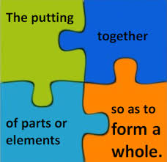
Evaluation Use in Practice
The Task
To synthesise the practices that influence the use of evidence from evaluations.
Mapping good practice across 4 areas to enhance learning and increase evaluation use.
The Process

Slide 3



Section 1
Ensuring relevance of evaluations to user knowledge needs.
The involvement of evaluation users to assist in the definition of the scope of the evaluation through the formation of an evaluation reference group.
The use of an iterative and generally formal analysis as an input into the decision-making on what to evaluate.
Using mixed methods including i) user consultation, ii) normative and coverage approach iii) application of existing criteria contribute to evaluation use at an organizational level.
Practice Trend
Practice Trend
Practice Trend

Slide 4



Section 2
Synthesising and communicating evaluation knowledge to increase appeal.
Evaluation offices have understood the benefits of effective communication to enhance the utilization of the evaluations.
Standard evaluation guidance generally recommends planning the communication of findings and dissemination from the initial stages of an evaluation.
The number of staff supporting communication efforts should be commensurate to the communication needs and strategy of the office.
Practice Trend
Practice Trend
Practice Trend

Slide 5

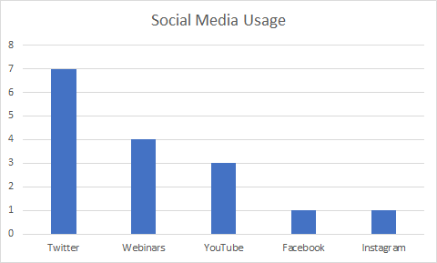

Section 2
Synthesising and communicating evaluation knowledge to increase appeal.
There is an understanding of the need to differentiate communication products according to the type of audiences to enhance the use of evaluation.
Members reported evidence that engaging in social media generates higher website traffic and increased awareness on evaluation work.
Beyond traditional written products other more innovative channels are increasingly being considered and used to share results and enhance evaluation use.
Practice Trend
Practice Trend
Practice Trend

Slide 6


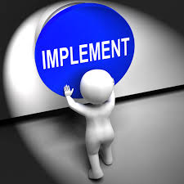
Section 3
Section 2
Tracking user uptake of evaluation knowledge.
Members repackage evaluation knowledge in the form of synthesis reports, mainly addressing key findings, lessons learned and recommendations as a response to user needs.
A management response to evaluation recommendations is a good practice approach and all evaluation offices have a system in place to track recommendations.
Reporting by EOs to their governing bodies on the status of recommendation implementation and further encouraging those bodies to act as an oversight mechanism for implementation.
Practice Trend
Practice Trend
Practice Trend

Slide 7

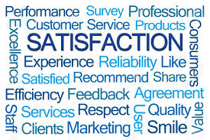
Section 4
Key Messages
Understanding user views on evaluation effectiveness.
Section 3
Evaluation user consultation is widespread
The importance of communication is recognised
Assessing evaluation use and impact, especially through recommendation tracking, is progressing.
Current UN agency practice allows for a partial understanding of change generated by evaluations.
Most UN agencies seek feedback on customer evaluation satisfaction through ad-hoc methods.
Practice Trend
Practice Trend

Slide 8
THANK YOU
Evaluation Use Interest Group
Aurelie Larmoyer
Adan Ruiz Villalba
questions

Slide 9
future lines of work for the evaluation interest group
Alignment with new UNEG strategy
“SO3: Influencing policy-making and operational work through evaluations”
Looking out and focus on external engagements through partnerships for innovative ways to influence (presentations)
Joint Evaluations and other products relevant to highest levels (SDG agenda, U.N Reform, etc) and new channels of communication
Exploring new ways of systemically influencing (behavioral public policy)

