Slide 1
HUMAN RIGHTS AND GENDER EQUALITY
WORKING GROUP
May 2019
Messay Tassew, Co-Chair Sabas Monroy, Co-Chair

Slide 2


PRESENTATION OVERVIEW
1. Achievements during 2018-2019
2. Key highlights on 2018 UN SWAP EPI Reporting Cycle Results
3. Emerging findings on UNDAF meta-synthesis with a gender lens
4. Next steps for 2019-2020
WORKING GROUP CO-CHAIRS
Messay Tassew, UN Women
Sabas Monroy, OHCHR
WORKING GROUP MEMBERS
UNFPA
UNHCR
UNICEF
ITC
UNIDO
WHO
GEF
FAO
UNDP
OIOS
OHCHR
UN Women
UNESCO
WFP
UNCDF
ILO
UNESCWA

Slide 3


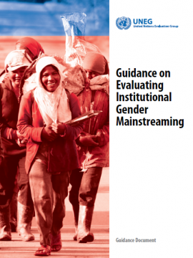
1. ACHIEVEMENTS DURING 2018-2019
UN SWAP Evaluation Performance Indicator and scorecard revised and widely circulated
New requirement for the exceed requirements introduced
Webinar organized on new requirements and changes introduced
Peer reviews facilitated to four UNEG members
Report on the 2018 UN SWAP EPI reporting cycle results finalized (42 reporting entities)
Guidance on Evaluating Institutional Gender Mainstreaming issued
Provided inputs to the development of a system-wide policy on inclusion of persons with disabilities and an accountability framework with special focus on evaluation indicator.

Slide 4
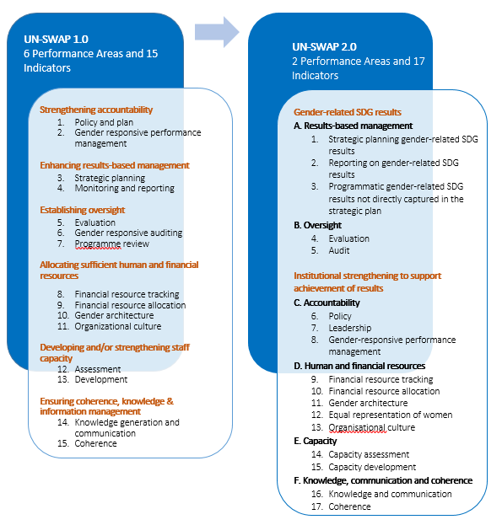


2. UN-SWAP EVALUATION PERFORMANCE INDICATOR
REPORTING AGAINST THE
UN SWAP 2.0 FRAMEWORK
STARTED IN 2018
2018 Reporting Cycle Results
Two new dimensions:
Gender-related SDG results
Institutional strengthening to support achievement of results

Slide 5





2.1 Key highlights of the 2018 UN SWAP EPI reporting cycle results
64%
88%
42 out of 66 reporting entities reported against the UN-SWAP EPI in 2018.
37 out of the 42 used the technical note and scorecard.
The analysis acknowledges the diversity in:
Mandates:
secretariat, funds and programmes, technical, specialized and training institutes
Capacity:
evaluation offices, units and co-located structures
Number of evaluations:
between 1 and 50 reports
Type of evaluations:
produced by central offices versus decentralized offices
Approaches:
internal, external and peer review

Slide 6
2.1 Key highlights of the 2018 UN SWAP EPI reporting cycle results
9%
Increase from 2017 in the use of UNEG scorecard
# Reports → Rating ↓ | 1–5 Reports | 6–15 Reports | 16–20 Reports | 21 or more Reports
Exceeds | DSS DGC OHCHR^ PBSO | OIOS ESCWA IOM | IFAD* | FAO UN-WOMEN* WFP*
Meets | OCHA OSRSG-SVC UNCDF^ ECLAC ITC WHO* WIPO WMO | ESCAP UNHCR UNFPA* | UNESCO UNODC* UNOV* | UN-HABITAT^ UNDP*
Approaches | UNV UNCCD IAEA UNCTAD UNRWA | ECE ILO* GEF |  | UNEP* UNICEF* UNIDO^
^Participated in PLE *External Review
73%
Of scorecard users (N=27/37) have met or exceeded the requirement for EPI
30%
External review
11%
PLE Participation
59%
Internal review

Slide 7


2.2 Key insights from the 2018 reporting cycle results
The UN-SWAP evaluation performance indicator has remained an important vehicle to reinforce entities efforts to integrate gender analysis in evaluation activities.
Number of entities that have conducted or planning to carryout evaluation of the implementation of their corporate gender polices and related action plan is increasing.
JIU review on UN SWAP 1.0 acknowledged UNEG’s role in advancing the integration gender equality concerns in evaluations and commitment to UN SWAP EPI.
Internal steps and remedial actions taken by entities helped to further incorporate the gender-related UNEG norms and standards within their evaluation practices.
Reporting practices vary, limiting the ability to generalize results across entities or to compare with previous reporting cycles.

Slide 8


3. UNDAF META-SYNTHESIS WITH A GENDER LENS
Two dual objectives:
Assess the gender and human rights responsiveness of a pool of UNDAF evaluations including the integration of the “leaving no one behind” principle.
Analyzing the UNDAF evaluations on gender equality results with key findings and recommendations.
Sample
48
2015-2019
5 regions
Out of a universe of 67 reports, 48 reports were selected representing UNDAF terminal evaluations
(All mid term reports were removed from the original list).
2015: 9 evaluations
2016: 15 evaluations
2017: 13 evaluations
2018: 10 evaluations
2019: 1 evaluation
19%
31%
27%
21%
2%
LAC: 9 evaluations
ECA: 6 evaluations
Africa: 23 evaluations
ASPAC: 6 evaluations
Arab States: 4 evaluations
19%
12%
48%
13%
8%
Notes:
This meta-synthesis is the first attempt by the UN Evaluation Group (UNEG) to use a gender lens to analyze UNDAF evaluations
A high percentage of UNDAFs include gender-specific outcomes (62%) and gender has been the highest area of concentration of joint programmes implemented by UNCTs (109 out of total 378)
Gender equality is one of the programming principles as per the UNDAF guidance
The 2030 Agenda – Gender standalone goal (SDG), 53 gender-related indicators (out of a total of 232 SDG indicators)
Grounded in human-rights, and focused on the promise to reduce inequalities and leave no one behind: eliminating inequalities and discrimination, human rights, and gender equality and women’s and girls’ empowerment.
However, little evidence available on the extent to which UNDAF evaluations have been conducted in a gender-responsive manner and assess progress against gender-specific results.
Given that the UNDAF will be the most central programming tool to operationalize the UNDS Repositioning, UNDAF evaluations will help to ensure that UNDAFs contribute more to gender equality and women’s empowerment.

Slide 9




3.1 METHODOLOGY - UNDAF meta-synthesis with a gender lens
UN SWAP EPI Criteria
3- FULLY INTEGRATED
2- SATISFACTORILY INTEGRATED
1- PARTIALLY INTEGRATED
0- NOT AT ALL INTEGRATED
The three criteria look at:
The scope and to what extent it integrates GEEW evaluation questions
The extent to which the methodology is gender responsive
Whether the findings, conclusions, lessons learned and recommendations take gender considerations on board
A maximum score of nine (9) could be achieved.
Summaries of each score for each of the three criteria was provided in an excel sheet with each individual score and overall score for each report.

Slide 10
3.2 Emerging findings - UNDAF meta-synthesis with a gender lens
19
25
4
Missing requirements:
19/48 scored between 0 – 3 (3 scored 1; 4 scored 2 and 12 scored 3)
Approached requirements:
25/48 scored between 4 – 6 (9 scored 4; 8 scored 5 and 8 scored 6)
Met requirements:
Only 4 out of 48 evaluations actually met requirements.
68%
77%
21%
23%
92%
10/48 reports stated how they would ensure data collection on gender and/or human rights
11/48 reports used disaggregated data
44/48 reports employed a mixed method approach
33/48 reports included some type of question(s) on GE&HR under one or more criteria (mainly under relevance and/or effectiveness)
37/48 used a diverse range of stakeholders
17%
31%
37%
29%
68%
8/48 included vulnerable groups in their analysis
15/48 evaluators cited the use of ethical standards
18/48 reports included either gender and/or human rights in the evaluation scope
14/48 reports included the unanticipated effects on gender and/or human rights
33/48 included recommendation on gender and/or HR
Notes:
14/48=29 reports included a separate section on either gender and/or human rights ( these sections were normally incorporated under one of the DAC criteria
30/48 reports did include some type of analysis on gender and/ or human rights in the background/context (60%). Only 12/30 reports was this analysis comprehensive (40%)
40/50 reports included some type of analysis of gender and/or human rights (80%) and how they had been impacted upon in the intervention (although many reports did not provide a comprehensive analysis and tended to cite what had been achieved, ie how many persons trained etc)

Slide 11



Strong correlation exists between quality of evaluation reports and integration of gender equality concerns. The reports which were deemed “moderately unsatisfactory” and “unsatisfactory” in assessment of quality all missed requirements. The reports which were deemed moderately satisfactory had a mix of results. The reports which were deemed satisfactory mostly either approached or met requirements (only one report was deemed to miss requirements).
The budget tended to have an overall impact both on the quality (externally assessed) and the score on the SWAP scale (with some exceptions). Except few exceptions, reports that met or approached requirements had a budget in the range of budget $30,000-$70,000.
Performance differences of UNDAF evaluations among regions is pronounced. There are weaknesses in the Arab States and Latin America & Caribbean Region whereby a higher number of reports “missed requirements”. Asia and the pacific, 71% “approaches requirements”, and in Africa 62% either “approaches requirements” or “meets requirements”. CIS had the highest number of “meets requirements” with 83% either “approached” or “met requirements”.
When looking at the time period (2015-2018), a pattern does not really emerge. The anlaysis found improvement on 2017 especially with regards to “approaches requirements”, and “less missed requirements”, however a pattern does not seem clear.
Notes:
A total of 23 reports in the sample have been externally quality assessed through UNDP IEO. The remaining reports have been lightly assessed by the consultant using the same framework.
Performance differences of UNDAF evaluations among regions is pronounced. When we look at the results by region, there are definite weaknesses in the results of the Arab Region and Latin America. While it can be acknowledged there are less evaluations from these countries, the sample analyzed is well representative of the original universe, with only one evaluation respectively being taken out from each region. As indicated in the slide, the number of reports which missed requirements in both these regions is high. As we can see from Asia and the pacific, 71 per cent “approaches requirements”, and in Africa 62 per cent either “approaches requirements” or “meets requirements”. In the CIS, which had the highest number of “meets requirements” (in terms of percentages) 83 per cent of evaluations either “approached” or “met requirements”.

Slide 12
The Terms of References do not tend to be gender responsive – a total of 30 ToRs were available, and only about 30% of these referred to and requested a human rights and/or gender equality sensitive approach in the scope. Only a handful of the ToRs required expertise in gender and/or human rights.
More male evaluators conducted UNDAF evaluations than females (48% v 38%)- Hiring female lead evaluators does not guarantee gender responsive evaluations (evaluations written by men scored higher on average on the SWAP EPI).
Although there is some mention to the SDGs in a number of reports, the UNDAFs under review were all developed before 2015, so many of the aspects of the SDGs and LNOB are not present.
The available data is inconclusive in explaining some of the variations. A full analysis of influencing factors against a range of variables is currently being carried out. This will be augmented by other data sources including survey and interviews to tease out the challenges faced by evaluators and evaluation commissioners.

Slide 13
3.3 Deliverables and timeline
Deliverable | Description | Deadline
Inception Report | Presents the scope, conceptual framework and methodologies to be used in the analysis. | February 15, 2019
Final Inception Report | Subsequent to feedback from the Reference Group | March 14, 2019
Assessment of the Gender Responsiveness of the UNDAF Evaluations | Excel sheet outlining a summary and scorecard for each SWAP criteria for each UNDAF evaluation under assessment. | April 18, 2019
Preliminary Findings | An overview of the findings from the first component | May 06, 2019
Draft Report of the first chapter | Draft of the first chapter of the report analyzing the findings of the gender assessment of all 50 evaluations | May 31, 2019
Draft Report of the meta-synthesis | Analysis done based on agreed conceptual framework and key overriding questions, including on gender equality results. Presentation of preliminary findings, and PPT outlining the preliminary findings, conclusions and recommendations. (including both chapters) | June 30, 2019
Final Report of the meta-analysis | Final report including an executive summary and annexes detailing the methodological approach after receipt of feedback. | July 30, 2019
Further analysis and drafting report – wider consultation - Component 1
An in-depth systemic review and analysis of evidence on gender equality results (Gender Result Effectiveness Scale (GRES) and SDGs as an analytical framework ) - Component 2
Survey materials under development (potential interviewees and survey respondents for the users/beneficiaries of UNDAF evaluations to be identified with UNDCO)
Analysis, triangulation, finalization, communication and dissemination

Slide 14
4. Next steps for 2019-2020
Finalization and dissemination of the final report of UNDAF evaluations meta-synthesis through various channels including webinar
Support development of technical guidance and roll-out of the policy and accountability framework on disability with especial focus on evaluation indicator
Facilitate collective space for exchange on ‘corporate evaluation of gender mainstreaming policy, strategy or equivalent’ across reporting entities, including dissemination of good practices and common challenges
UN SWAP Evaluation Performance Indicator 2019 Annual Synthesis of results and webinar

Slide 15
THANK YOU

