Slide 1



UNEG Inventory of SDG/Evaluation-related Instruments, Tools, Training and Other Initiatives
Co-conveners ILO/UNDP
Survey results
UNEG AGM Meeting, 17TH May 2017
Working Group on Sustainable Development Goals (SDGs)
Notes:
1

Slide 2
Background
SDG Working Group
Work plan
UNEG Inventory of SDG/Evaluation-related Instruments, Tools, Training and Other Initiatives

Slide 3
Main highlights

Slide 4
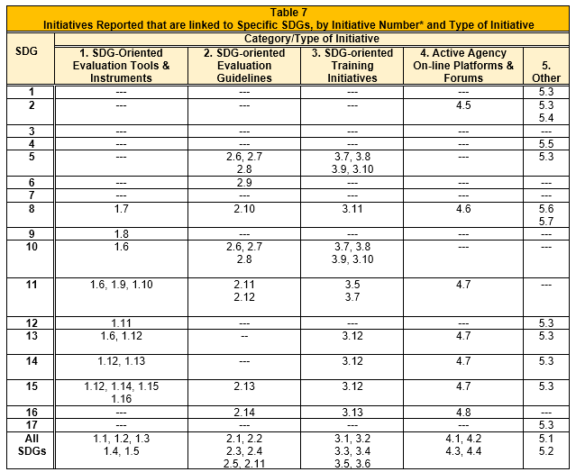
SDG initiatives

Slide 5
Target groups and synergies

Slide 6
Summary
Initiatives under development or in the draft stage, with few that have operational follow-through
Internal work
Scarce collaboration

Slide 7
Next steps
Strengthening the role of evaluation in the review processes of progress on SDGs:
UNEG compendium of existing capacity building resources
SDG-relevant UNEG Guidelines and Tools on evaluability and capacity development
Outreach – Partnerships to advocate and promote evaluation of SDGs
Support evaluations of SDGs
Support knowledge dissemination on SDG and evaluation

