Slide 1

UN Reform & the Opportunities for UNEG and its membership
Evaluation as a Lever for Change
Nairobi, 16 May 2019
Susanne Frueh
UNEG Chair

Slide 2

Agenda 2030
  Links for the first time all relevant global agreements in one compact Agenda
  Not only oriented towards development countries but a common Agenda for all countries
  17 SDGs and 169 Targets
  Complexity, inter-relatedness and measurement are some of the key challenges
  Evaluation kept off the table – focus on self-evaluation through the VNRs and on data collection/statistics
  Creation of a mega platform for monitoring and reporting…and not so much yet for evaluation

Slide 3
Significance of the SDGs
Uniformly applicable commitment to shift development to sustainability
  to all countries of the world, to local and subnational governments, civil society and the private sector
Establishes a set of objectives with quantifiable and verifiable indicators to be reached by 2030
  environment, economy and society as embedded systems rather than separate competing pillars. Inclusivity: “no one will be left behind.”
Expectations on evaluation
  Accountability to demonstrate SDG results
  Vital necessity to understand what works and what does not, and why
  Impact of system-wide agendas can only be assessed through system-wide evaluation

Slide 4
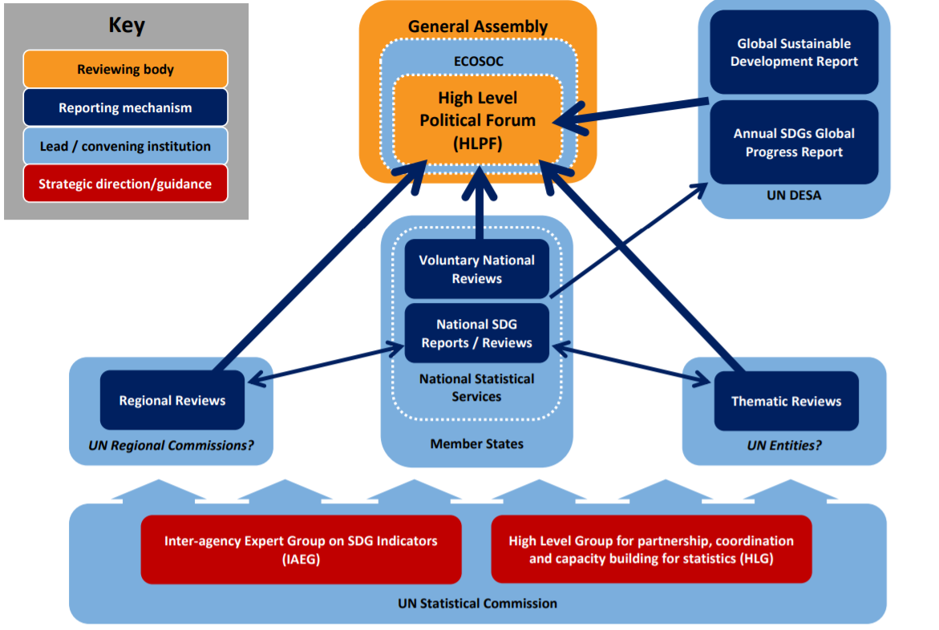
SDG review and follow-up UN ecosystem

Slide 5
Challenges in times of complexity
Complexity of the 2030 Agenda, including the inter linkages between the SDGs, are challenging the evaluation community like never before
SDGs are ecosystems not a hierarchical systems
  Environment, economy and society as embedded systems rather than separate competing pillars
  Positive and negative linkages are as important than the elements of the system themselves
Understanding how SDGs work requires innovative approaches
  Not possible to decompose phenomena into manageable pieces
  SDGs must be analysed from different perspectives, combining qualitative and quantitative data

Slide 6
Assumptions built into the SDG framework
An integrated planning, implementation and monitoring system
  National governments development agenda increasingly aligned with SDG architecture
  Enhanced coordination of UN agency activities within national development agenda
Country monitoring capacity
  Country data robust and timely to populate relevant SDG indicators and demonstrate progress or lack thereof
  Country capacity for analysis and the conduct of country-led systematic ‘follow-up and review’/evaluation
Availability of resources
  Massive investment requirements to finance SDG implementation and monitoring – Risk of North/South divide
  Leveraging and catalysing a combination of private investment, international and domestic public resources

Slide 7
Linking SDGs and the UN Reform
UN Development System Reform
  Focus strategy at the country level to meet national SDG objectives
  SDGs as the common language for coordination within UN and beyond
Improving UNDS performance to meet SDGs
  Address challenges of duplication and overlap, fragmentation, competition for funds and lack of strategic approach
  No to do everything, everywhere, but repositioning UN as advisor / provider / broker of technical support in matters of sustainable development
Working as a true system, including for evaluation
  Existing fragmentation also in the evaluation work of UNEG members

Slide 8
Gaps in system-wide evaluation
No system-wide evaluation mechanism
  Individual evaluations evaluating one single intervention cannot provide answers as to which SDGs are being met, and why
  No oversight to the totality of evaluation work beyond a single UN entity
Limited success of pilot system-wide evaluations
  Difficult to address complexity and cost of coordination
  Issues with ownership, utilization, as well as credibility
Consequences of a piecemeal approach
  Heavy demands on already stretched UN evaluation offices, which are fully engaged in UN Agency work
  Evaluations refer to the SDGs but no real systematic evaluative evidence if UN Agency contribution to SDGs achievement

Slide 9
UNEG’s role to date
Filling gaps and contributing to an enabling environment
  Management of joint and system-wide evaluation of SDG on an ad-hoc basis
  Evaluability assessments of the SDGs, training courses on how to manage SDG evaluations, national capacity development
Advocating for system-wide evaluation capacity
  Since 2007, UNEG has been contributing with scenarios on the potential scope, governance and funding of a system-wide evaluation capacity
  Interim coordinating mechanism developed first ISWE policy 2013 and accompanied two pilot ISWEs
  Independent review of the pilot called for setting up an independent unit
  SG report of 2017, recognizes need for ISWE and indicates intention to set up a small independent system-wide evaluation capacity
  Funding Compact and UNDAF guidelines contributions in 2019

Slide 10
Objectives for system-wide evaluation
2019 Funding compact
  Takes the form of mutual commitments between UN Development System and member states
  Addresses need for a more stable basis for UN to meet the ambitious goals and timelines set out in the 2030 Agenda
Evaluation-related commitments
  Commit to engage in joint-evaluation or system-wide evaluation
  Improve the quality and utility of UNDAF evaluations
  Greater transparency through publication of evaluation reports on UNEG’s website organized by SDG

Slide 11
UN Funding Compact Commitments (1)
To increase collaboration on joint and independent system-wide evaluation (ISWE) products to improve UN support on the ground
% of UNSDG Evaluation Offices (EO) engaging in joint or ISWE; Baseline (2018): 10/35 or 29% of EOs have engaged in joint evaluations; Target (2021): 75% of EOs will have engaged in a joint evaluation; Baseline (2018): 7/35 or 20% have engaged on an ISWE product; Target (2021): 50% of EOs will have engaged in at least one ISWE
2. To improve the quality and utility of UNDAF evaluations
% of UNDAF evaluation reports with good or excellent rating on methodology used; Baseline (2016): 10/36 or 28%; Target (2021): 75%
% of UNDAF evaluations that contain all the following: actionable recommendations, with a clear target audience and timeframe for implementation, and a management response; Baseline (2016): 10/36 or 28% (23/62 for management response); Target (2021): 100%

Slide 12
UN Funding Compact Commitments (2)
3. To increase accessibility of corporate evaluations and of internal audit reports, within the disclosure provisions and policies set by governing bodies at the time of report issuance
% of UNDS entities authorized within disclosure provisions and policies who have made their corporate evaluations available on the UNEG website; Baseline (2018): 10/48, or 21%; Target (2019): 100%
% of internal audit reports issued in line with the disclosure provisions and policies set by the relevant governing bodies, which are available on a dedicated searchable UN-RIAS platform/ website, pending availability of resources; Baseline 2018: 0; Target (2021): 100%
% of inter-agency pooled funds posting evaluation reports on the UNEG website Baseline; Baseline (2018): 0%; Target (2019): 100%

Slide 13
2019 Roadmap for implementation
Main activities
  Update the 2013 policy on independent system-wide evaluation
  Establish a interim capacity to coordinate/manage SWE
  Develop multi-donor trust fund to ensure future funding for system-wide evaluations
UNEG’s contribution
  Building on what UNEG has to offer as a professional network and its Norms and Standards
  UNEG will second a senior staff to help develop and start up the architecture with funding being provided by a member state for the first year of activities

Slide 14
Suggested key priorities:
Mapping future plans for single and joint evaluations by SDG and by country
  ensure evaluations use consistent criteria, ask the same key questions and collect pre-defined data so that can then inform system-wide analysis
  forge partnerships by SDG at the country and global levels
Increase meta synthesis of existing evaluative work – including beyond the UN
Engage in joint evaluation through “coalitions” of those UN Agencies that have significant work in a specific area
Review and update UNEG guidance on joint evaluation, adding SWE
Gauge demand for system-wide work (e.g. real-time, prospective, cross-cutting etc.)

Slide 15

Who is Who in the UNEG-SDG Ecosystem?
SDGs | Possible UNEG Lead Agency* | Other Key Agencies | Total Expenditure by SDG (USD Milllions)**
 | UNDP | UN-Habitat, UNICEF | 1,828
 | WFP | UNICEF, WHO, WFP, WTO, FAO | 5,895
 | WHO | UNICEF, UNAIDS, UNODC, UNOPS | 5,431
 | UNESCO | World Bank, UNICEF, UNEP, UN WOMEN | 1,595
 | UNICEF | UN WOMAN, UNFPA, FAO, ILO, UNODC, UNDP | 628
 | WHO | UNICEF, UNEP, FAO, UNEP, OECD | 811
 | IAEA | UN-ENERGY, UNDP, UNEP | 226
 | ILO | IMO, World Bank, UNEP, UNWTO | 934
 | UNIDO | UNEP, UNICEF, World Bank, UNIDO, IOM | 588
 | UNDP | ILO, IMF, IOM, UNDP | 1,101
 | UN-HABITAT | UNISDR, UNEP, UNESCO, WHO, UNOPS | 1,131
 | UNEP | UNSD, UNESCO, FAO, UNEP | 90
 | UNEP | UNISDR, UNESCO, UNDP, FAO, UNEP, UNOPS | 939
 | UNEP | FAO, UNESCO, UNEP | 264
 | FAO | FAO, UNEP, World Bank, UNDP | 513
 | UNODC | UNICEF, World Bank, UNDP, OHCHR | 3,918
 | UNDP | UNICEF, World Bank, UNEP, WFP | 1,689
*SOURCE: Tier Classification for Global SDG Indicators (4 April 2019) ; https://unstats.un.org/sdgs/files/Tier%20Classification%20of%20SDG%20Indicators_4%20April%202019_web.pdf) **SOURCE: UNDS survey estimates included in the Dalberg Report (2017). System-Wide Outline of the Functions and Capacities of the UN Development System (p. 8) https://www.un.org/ecosoc/sites/www.un.org.ecosoc/files/files/en/qcpr/sg-report-dalberg_unds-outline-of-functions-and-capacities-june-2017.pdf

Slide 16
How could we plan for producing evaluative evidence?
2016
2017
2018
2019
2020
2021
2022
Ensuring that no one is left behind
Eradicating poverty and promoting prosperity in a changing world
Transformation towards sustainable and resilient societies
Empowering people and ensuring inclusiveness and equality
TBC
TBC
TBC

Slide 17
Supporting evaluation at the country level
Agency-only evaluation
  Will need to also feed into UNDAF evaluations and bigger picture
UNDAF evaluation
  Main accountability instrument for gauging the UN contribution to SDGs at country level
  Not evaluate the individual activities, but build on the evaluations conducted by each UN Agency
  Promote national ownership while preserving independence and quality of evaluation
Building national evaluation capacities
  Pooling resources at country level in collaboration with regional evaluation networks and training providers

Slide 18
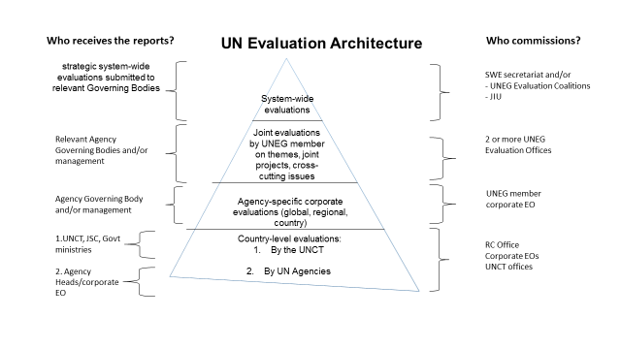

Slide 19
Necessary ingredients for success
Utility ➔ Timely and relevant inputs to decision-makers (opportunity and demand based)
Credibility/Independence ➔ N&S safeguarding; mobilize evaluators with strong technical background who can deliver on complexity; non-biased and transparent processes;
Incentivation ➔ Considering limited resources available for SWE, any increase will likely remain marginal unless incentive systems are developed (pooling of funding, RM, formal recognition for SWE work, platforms for tabling and responding to reports)
Inclusiveness ➔ Engaging all relevant stakeholders

Slide 20
Thank you for your attention!
Susanne Frueh
Chair, United Nations Evaluation Group

