Slide 1


AGM Nairobi, Kenya
16 May 2019
UNEG Strategy 2020-2024

Slide 2
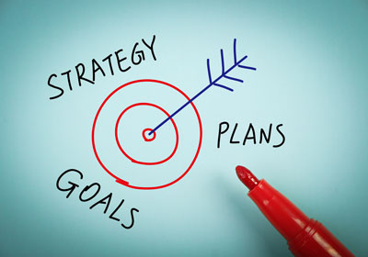
Key features
Vision and Mission
Theory of Change
Strategic Objectives
Implementation
Monitoring and evaluation

Slide 3

Vision
UNEG envisions that evaluations within the United Nations System produce knowledge and evidence used to inform relevant, coherent, sustainable, effective and efficient delivery towards the achievement of the Agenda 2030, contribute to good governance and oversight of the United Nations system, and positively impact the lives of the people we serve.

Slide 4
Mission
UNEG’s mission is to promote, strengthen and advocate for a robust, influential, independent, innovative and credible evaluation function throughout the United Nations system to support decision-making, accountability and learning.

Slide 5
UNEG Theory of Change
ii. Work of UN Evaluation
Functions Members
iii. Evaluation contributions to the UN system
v. Outcomes in the UN system & beyond
vi. A Better World
Strategic Objectives
i. UNEG Work
What we do together
What UN Evaluation functions achieve with UNEG support
What we contribute to change in our own agencies and our stakeholders
The changes in the UN system, in Member Nations and in the evaluation profession
2030 Agenda realized, impacting the lives of the people we serve
1. Developing and safeguarding professional norms, standards and guidance
Norms & Standards
Guidelines
Peer Reviews
Partnerships
2. Enhancing Professionalization
Evaluation Competency Framework
Knowledge exchange
Learning
Partnerships
3. Influencing policy-making and operational work
Engaging with and supporting system-wide initiatives e.g. UNDAF, ISWE, SDG/HLPF
Partnerships
A robust, influential, independent, and credible evaluation function exists throughout the UN system for decision-making, accountability and learning
Evaluation contributes to improvement as well as to evidence-informed decision-making and policy/programme governance and oversight
More relevant, effective and efficient UN system
1. SDGs Achieved
2. No-one left behind
1. More relevant, effective and efficient UN programmes
1. Gaps in evaluation policies, capacities and practices are identified and addressed
Evidence from UN evaluations is used to improve:
Country, regional or global projects, programmes, strategies or policies in UN entities
System-wide or collaborative initiatives
2. More relevant, effective and efficient UN coordination/collaboration
D
2. Evaluation functions apply/meet UNEG norms and standards, including on gender and human rights
Developing and safeguarding professional norms, standards and guidance
Enhancing professionalization
Influencing policy-making and operational work through evaluations
3. Evaluation functions are staffed with competent professionals
C
4. Evaluation functions are kept abreast of professional advances and innovative practices, and are capable of carrying out credible evaluations
3. Evaluation is an integral part of national development frameworks, and inform more relevant, effective and efficient national policies and programmes
2. Evaluation is used to influence UN system-wide initiatives
B
iv. Beyond the UN system
5. Evaluation functions and their staff provide evaluative thinking and foster an evaluation culture in their organizations
A
6. UNEG members conduct joint evaluations at all levels, in development and humanitarian contexts
Non-exhaustive list of assumptions / preconditions:
A:
Broad adoption and use of UNEG normative products
Adequate engagement of staff and funding for UNEG work
B:
Political will by Governing Bodies and Management to support evaluation
Demand for and use of evaluation products and services
C:
Willingness by UN and MS to act upon evaluation recommendations
Interest in UNEG products and services by partners and national evaluation functions
D:
Ownership and commitment to programme improvement and scaling-up by member states, the UN system and partners
1. Guidance and initiatives carried out by UNEG, its members and partners contribute to enhance the global evaluation profession
7. UNEG members undertake and/or collaboratively engage in capacity development initiatives beyond the UN
8. Executive Heads and Governing Bodies are assured and support evaluation functions appropriately, recognizing their role and value
2. National evaluation systems strengthened

Slide 6
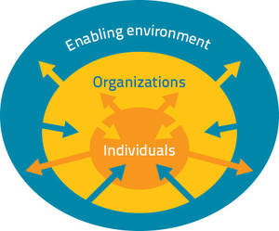
Strategic Objectives
Developing and safeguarding professional norms, standards and guidance
Enhancing professionalization
Influencing policy-making and operational work through evaluations

Slide 7

Implementation and M&E
Partnership as the new way of working
Need for:
  New/revamped WGs/interest groups: methodologies (CAPDEV); innovative practices; peer reviews?
  Involving the entire UNEG community, also junior evaluation officers
Regular reporting of progress towards SO targets and KPIs

Slide 8

Open discussion
What should be in UNEG’s scope and what should not?
What are the most critical things we need to focus on as a coalition/network to achieve our vision and objectives?
What are the implications for how we could work together through the current working groups or through other ways?

Slide 9
Thank you for your participation!

