Slide 1
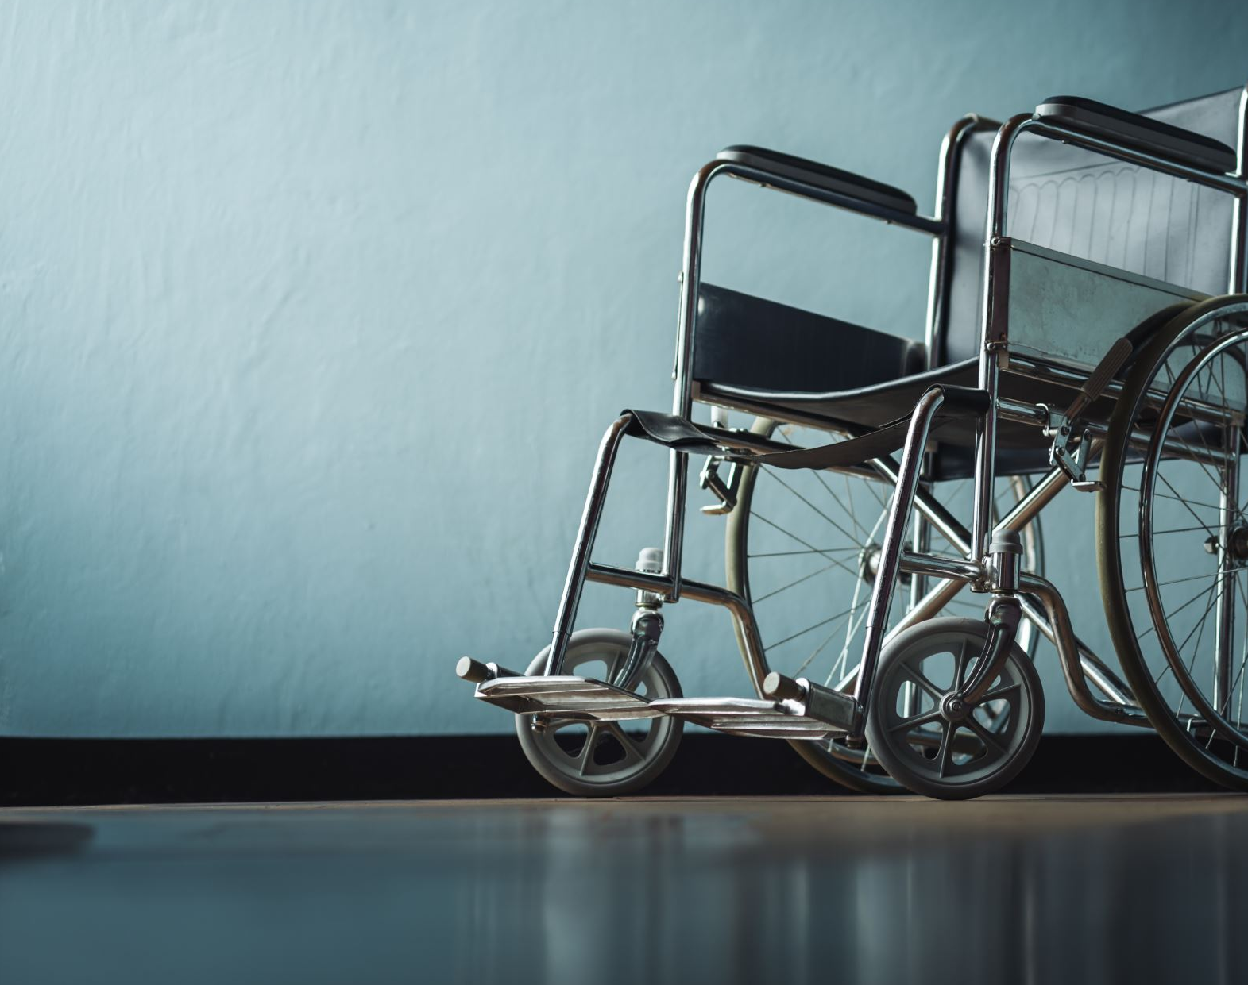
UNEG EPE on
Disability Inclusion
18 Oct 2023
Presentation from OIOS
Nicholas (Nick) Kowbel, OIOS Evaluator, and Disability Inclusion Focal Point

Slide 2

Mainstreaming Cross-cutting Issues in Evaluations
OIOS-IED Guidance

Slide 3
CONTEXT
Proliferation of cross-cutting issues:
  Disability inclusion (Nicholas Kowbel)
  Environment (Ellen Vinkey)
  Gender (Angela Arévalo, now Jillian Baker)
  Human Rights (Natalie Neil)
OIOS mandates and Senior Leadership commitment
UNEG (UN Evaluation Group) norms and standards
UNEG Guidelines on Disability Inclusion (2022)

Slide 4
IMPLEMENTATION
Awareness raising
workshop
Updates in Division meetings; broadcast of UNEG events; advocacy with IED management team
Dedicated workshop on “learning by doing” mainstreaming; part of “outcome focus” series of workshops
Design focus
Guidance
Focal points review Inception Papers and highlight opportunities to mainstream cross-cutting issues
Produced a Mainstreaming Guidance and Checklist document
Finalized and presented to OIOS in Oct 2022;
Adapted for Secretariat Evaluation Functions in 2023

Slide 5
Mainstreaming Guidance Overview
1. Include mainstreaming considerations in inception phase
2. Prioritize cross-cutting issues during scoping
3. Include at least 1 eval question
4. Inclusive data collection
5. Cross-cutting issue stakeholder data analysis
6. Reporting and recommendations
Statement of Intent: IED evaluators required to consult this guidance
Overview of relevant mandates for easy reference
Suggested paras for Inception Papers
Six Point Checklist which:
  Considers issues at all stages of the evaluation
  Is based on LNOB principles
  Is based on IED practice and UNEG guidance
  Includes practical suggestions
Evaluation question and indicator banks
Additional online resources

Slide 6





1 and 2: Evaluation Planning
Consult UNEG’s professional standards
Consider issues in background research
Initially discuss issues with evaluand
Consider mainstreaming in ToC design
Seek relevant expertise

Slide 7


3. Evaluation Design
Consider issues in evaluation design
Develop specific, overarching or embedded questions
Specific question: ‘To what extent, is this entity factoring in consideration of impacts on natural systems?’
Overarching question: ‘What, if any, tangible results have been achieved through the integration of mainstreaming issues into the work of the entity?’
Embedded question: ‘What were the main results achieved by the project? To what extent these results reached women, persons with disabilities and the youth?’

Slide 8




4. Data Collection
Mainstream issues in instrumentation and disaggregate data
Conduct accessible data collection
Ensure inclusive consultations
Adhere to ethical standards

Slide 9

5. Data Analysis
Triangulate data for inclusion; disaggregate where possible
Consider conducting power analysis

Slide 10




6. Reporting and Recommendations
Ensure inclusion of issues in overall result statement or embed in broader results
Include a standalone recommendation where relevant
Report absence of mainstreaming in programming
Provide supplemental analysis where useful

Slide 11
One year later OIOS Meets Indicator 10 requirements….
2022 was the first year of this reporting for OIOS on UNDIS indicator 10 (Baseline year); more work to do
Findings Summary
100% (7/7) of OIOS evaluation reports met UNDIS requirements.
100% of evaluation teams had knowledge and/or experience of disability inclusion, though only through OIOS-IED disability inclusion focal point (sustainable?).
71% of evaluations questions covered different aspects (more than one) of disability inclusion.
29% of evaluations involved persons with disabilities and their representative organizations in stakeholder mapping and data collection methods.
100% of evaluation teams analyzed data and evidence on disability inclusion, though two teams did not refence these findings in the final report due to space and relevance issues
57% of evaluations made conclusions and/or recommendations on disability inclusion.

Slide 12

Biennial Team:
Zainab Latif
Maria Goldman
Maria Delgado
Léa Ginon Moreno
Catherine Nyawire
Yuen Ching Ho
Biennial 2020-2021
Strengthening the role of evaluation and application of evaluation findings on programme design, delivery and policy directives for 2020-2021

Slide 13
OIOS biennial Context
Mandated in ST/SGB/2018/3 – produce a report to the GA summarizing findings
Universe of UN secretariat entities (75 – Operational, Peacekeeping, Management)
Reviewed reports, evaluation policies, interviewed staff, funding, survey of focal points

Slide 14
disability inclusion Key findings
First year incorporating disability inclusion in biennial
Assessment did not contribute to the overall quality rating, but will in future (baseline established)
Disability issues found to be weakly integrated in evaluation reports, but some good practices emerging
Biennial 2020-2021
Strengthening the role of evaluation and application of evaluation findings on programme design, delivery and policy directives for 2020-2021

Slide 15
Disability inclusion issues were weakly integrated and rarely analyzed in 2020-2021
Key challenges with inclusion (evidence from interviews):
  Not easily accommodated in mandate (more awareness, socializing the policy)
  Too many cross-cutting issues
  No/new guidance (UNEG guidance only released in 2022)
  Time to adapt – gender also took many years to incorporate systematically and is still in progress

Slide 16
Examples of Reports demonstrating good practices for integration of disability inclusion

Slide 17
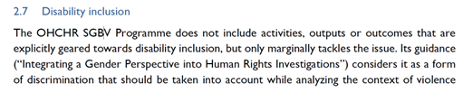
OHCHR 2017-2020 Cambodia country programme
Disability inclusion added as a specific evaluation criterium. Specific questions under all core lines of enquiry with stakeholders
Representatives of disability CSOs included among stakeholders consulted for the evaluation and during evaluation (including the CSO national disability umbrella body), as well as with the Disability Action Council (DAC)
Disability considerations integrated into all aspects of the evaluation.

Slide 18
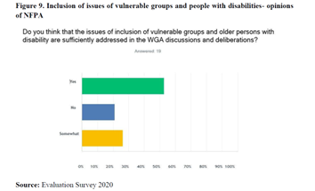
2020 UN ECE Eval of Population Component of the Housing, Land Management and Population subprogramme
Specific questions address disability inclusion issues
“Does the Population subprogramme incorporate the perspective of vulnerable groups in its work? Is disability inclusion mainstreamed in the activities of the subprogramme?”

Slide 19
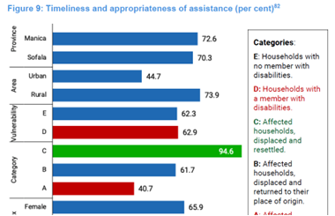
Inter-Agency Humanitarian Evaluation of the Response to Cyclone in Mozambique (2020)
Disability included among the criteria used in the sampling strategy (paragraph 58-see below)
Results disaggregated according to gender, disability and three displacement categories (see figure 9 below)
The needs of people with disabilities in times of an emergency fully addressed throughout the report

Slide 20

Materials Discussed in this Presentation
OIOS Six Point Checklist on Mainstreaming
Adapted OIOS Guidance to Secretariat Entities on Mainstreaming. Secretariat entities can contact OIOS for assistance at OIOS-ES@un.org
Biennial Review of Secretariat Evaluation Functions 2020-2021 (A/78/70)
Secretariat Entity Biennial Review Dashboard 2020-2021

